Slide 1
Places
Theme: Men and Society
PPT模板 http://www.1ppt.com/moban/

Slide 2

Target Students
sophomores majored in Tourism Management
They are interested in exploring different places. | They are weak at productive skills: talking and writing about places in English.
They already have the background knowledge of managing, planning, and analyzing a place as a tourist destination. | They need guidance on autonomous learning before and after class.
√
Target Students
weak at productive skills: speaking and writing
weak at autonomous learning and 4C skills ( communication, collaboration, creativity and critical thinking)
Sophomores, tourism management

Slide 3

Teaching Methods
CLT
Communicative Language Teaching

Slide 4
Learning Objectives
Knowledge objectives
Ability objectives
Value objectives
to understand the Text A and Text B and learn related vocabulary and expressions
to get to know the chronological writing structure to describe changes and development of a place
to get to know the writing structure of an exposition describing different aspects of a travel destination
to practice fast and detailed reading skills: skimming, scanning, decoding...
to be able to ask for and give directions to find the way
to be able to wirte emails to people to talk about travel experience
to be able to complete the project to introduce the beautiful, worth-visiting rural areas as travel destinations in China
to acknowledge that many poverty-stricken areas in China which are also with the richest tourism resources now are developing repidly with the effort made by the Chinses government
to encourage students take actions to introduce those places to the world
to motivate students for autonomous learning through befor and after class tasks

Slide 5
Unit Topic: Places
Theme: Men and Society
Sub-topic 1
Domestic China’s Stories
Sub-topic 2
Overseas China’s Stories
Sub-topic 3
Telling China’s Stories
Listening & Speaking
Asking for and Giving directions in “Cliff Village”
Reading
“Chinatown in London
Group Project
Introducing a worth-visiting rural place in China to the world
Listening & Speaking
“How is London’s Chinatown”
Reading
“Cliff Village”
Writing
Email writing: Travel experience
Directions
&
Location
Changes
&
Development
Touristic aspects
Travel experience

Slide 6
Teaching Material
Reading“Cliff Village”
Prosperity
Poverty
Development and Changes
2016 2017 2019 2020 in the future

Slide 7
Demonstration
Cliff Village

Slide 8

Warm-up

Slide 9

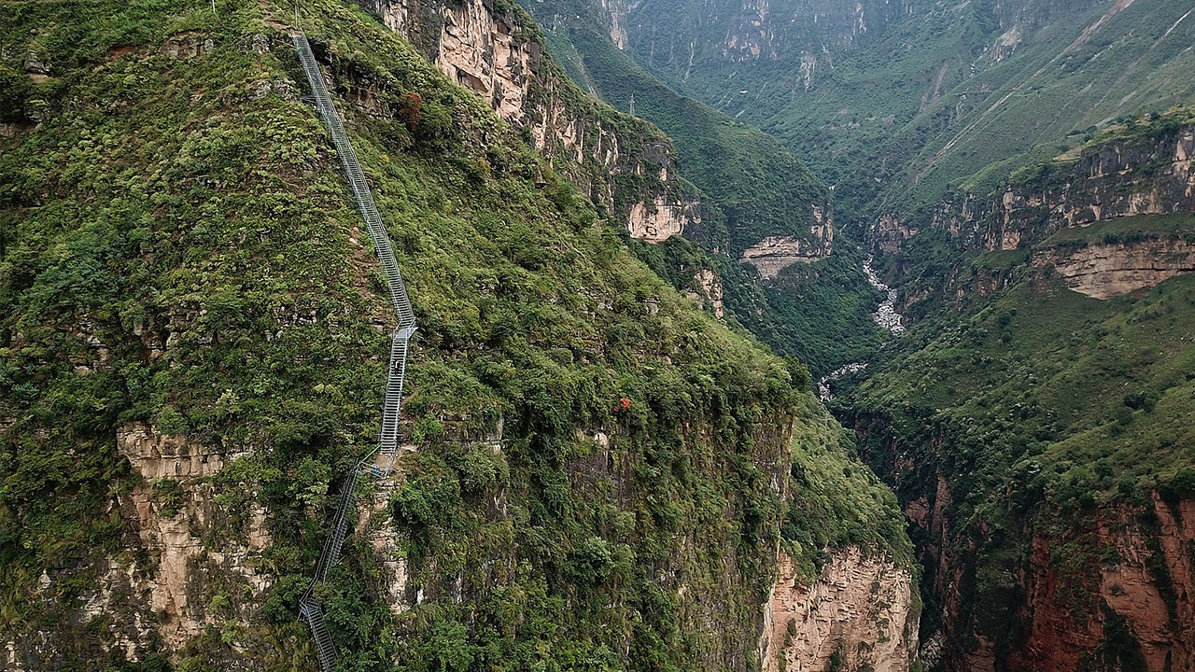
Pre-reading
discussion
Cliff Village

Slide 10
While-reading
Fast Reading
1. Where is this “Cliff Village”?
It is on a top of a mountain in Liangshan Yi Autonomous prefecture of Southwest China’s Sichuan Province.
2. Find out the time markers in the text.

Slide 11
While-reading
Fast Reading
Detailed reading (Jigsaw reading)
in the future
2020
2019
2017
2016

Slide 12
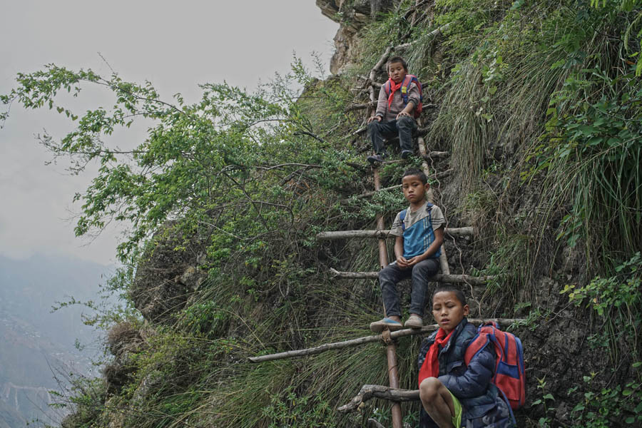
While-reading
Detailed Reading
Vine ladder
800 metres
2 hours
2016

Slide 13
While-reading
Detailed Reading
Detailed reading
in the future
There was a vine ladder.
2020
It took 2 hours to make the journey.
2019
2017
2016

Slide 14
While-reading
Detailed Reading
Change Listing
 | 2017
Change 1
Change 2
Change 3

Slide 15
While-reading
Detailed Reading
84 families moved to new houses.
... a kindergarten, schools, a hospital and a playground.
100,000 tourists came to the village.
A new steel ladder was built.
Villagers earned 1 million yuan.
2020
... was connected to electricity and internet.
2019
2017

Slide 16
While-reading
Detailed reading
84 families moved to new houses.
100,000 tourists came to the village.
... a kindergarten, schools, a hospital and a playground.
A new steel ladder was built.
Villagers earned 1 million yuan.
in the future
There was a vine ladder.
... was connected to electricity and internet.
2020
It took 2 hours to make the journey.
2019
2017
2016
past tense

Slide 17
While-reading
Detailed reading (Jigsaw reading)
Is it a real museum?
cable cars
cliff-style hotels
open-air museum
in the future

Slide 18
While-reading
84 families moved to new houses.
The village will have cable cars, cliff-style hotels and an open-air museum.
100,000 tourists came to the village.
... a kindergarten, schools, a hospital and a playground.
A new steel ladder was built.
Villagers earned 1 million yuan.
in the future
There was a vine ladder.
... was connected to electricity and internet.
2020
It took 2 hours to make the journey.
2019
2017
2016
future tense
past tense

Slide 19
While-reading
84 families moved to new houses.
The village will have cable cars, cliff-style hotels and an open-air museum.
100,000 tourists came to the village.
... a kindergarten, schools, a hospital and a playground.
A new steel ladder was built.
Villagers earned 1 million yuan.
in the future
There was a vine ladder.
... was connected to electricity and internet.
2020
It took 2 hours to make the journey.
2019
2017
2016
Government
Villagers
Society

Slide 20
While-reading
Detailed reading (Jigsaw reading)
2016
2020
What has our government done?
Our government has moved about 9.3 million citizens from their homes to better places. (Para. 7)
not only
improved lives of millions of Chinese people
but also
reduced global poverty rates

Slide 21
Post-reading
At the end of 2020, China achieved the goal of eliminating extreme poverty.

Slide 22
Post-reading
Brainstorm
Are there more?
2556
steps of the ladder
transportation
medical care
the number of the tourists
education
100,000
tourism
One million
the income brought by tourists
entertainment
84
families that moved to new houses
accommodation
... ...

Slide 23



Post-reading
Apply and Create
Rural revitalization project in Cliff Village
Hundreds of training sessions were provided to promote employment
a 750-meter cableway was built to access the village
In the future
2023
2021

Slide 24
Feedback & Summary
chronological writing structure to describe changes in a place
efforts made to develop the rurals areas in China
the huge changes and development taking place in China

Slide 25
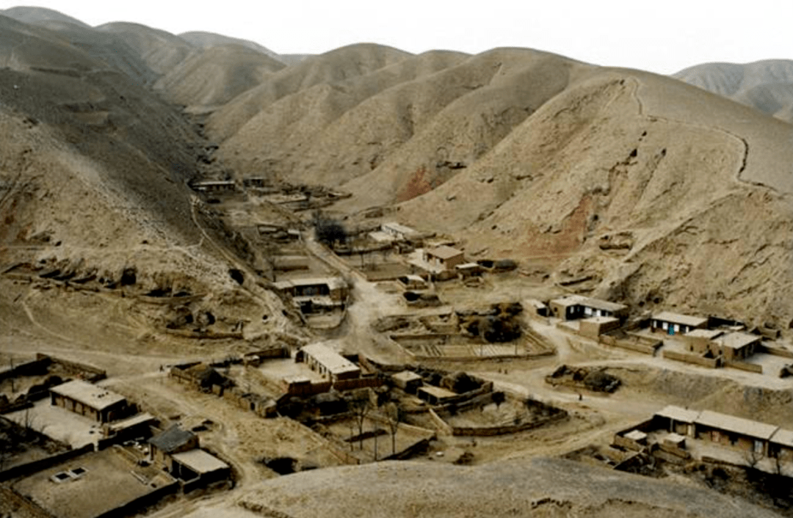
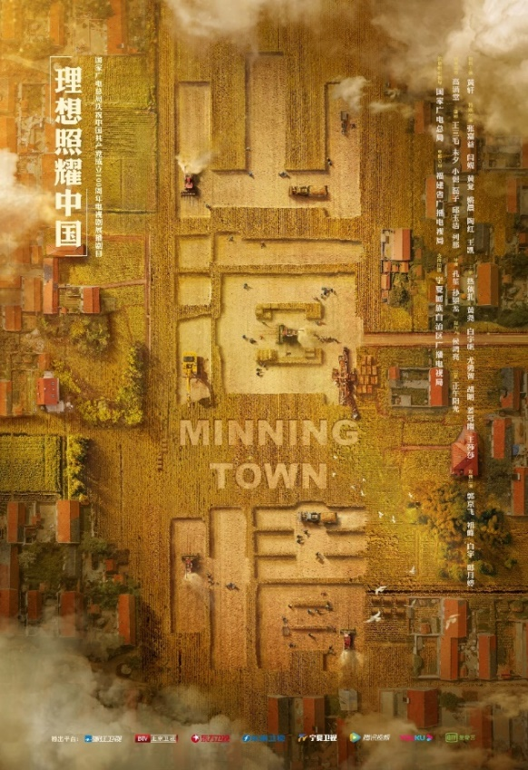
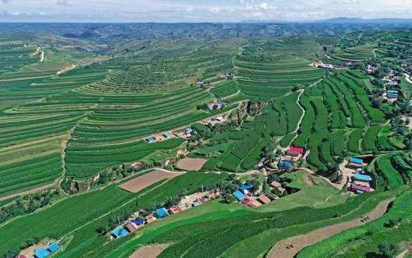
After-class task(Assignments)
Homework
Search information about Minning Town
In the past
Make a mind-map about changes and development of this town
Present it orally in the next class
Now

Slide 26
Thank You!

