Slide 1
PART
ONE
Instructional Design

Slide 2
One
Target Students
First-year non-English majors
Advantages:
1. They have a relatively wide vocabulary;
2. They are active and eager to learn.
Disadvantages:
1. They don’t have enough examples;
2. They are still weak in organizing their thoughts;
3. They are easy to be swayed by other people’s opinions.
Major Challenges

Slide 3
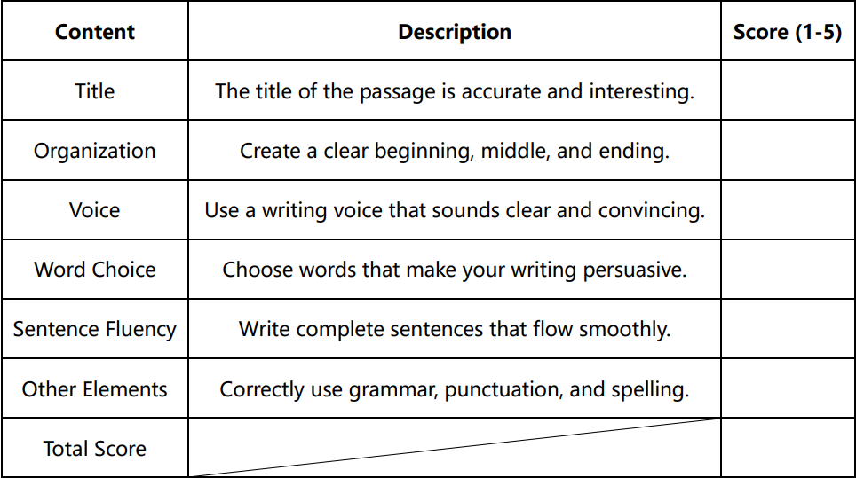
Three
Teaching Procedures
Challenge 3 tackled
TBLT + POA
Text A
Preview the text A;
Finish the new words.
After They Leave
Challenge 1 and 2 tackled
Presentation
1 period
Text A
1. Share an ad that is quite persuasive with classmates;
Text B
2 periods
1. Finish their writing (based on their stance);
2. Find more persuasive sentences under the topic and take them down.
Text A
3 periods
1. Continue to learn and practice;
2. Exchange their essays within their group (with criteria).
1. Learn persuasive essay ;
2. Independently analyze and judge Text B;
2. Analyze and appreciate;
3. Write an outline for the critical thinking (lines);
3. Critical thinking (dots).

Slide 4
PART
Two
Demo Class

Slide 5
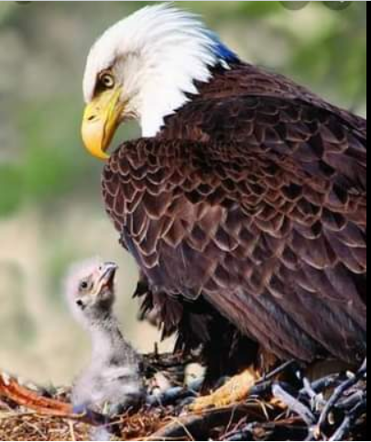
Think About It
How do baby eagles learn to fly?

Slide 6
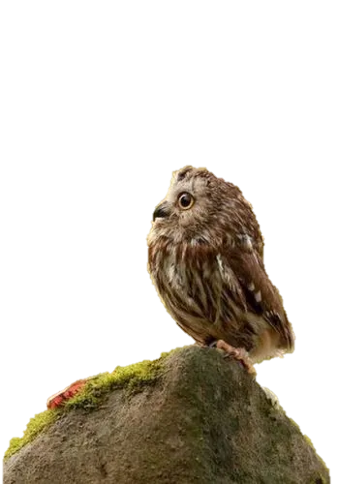
Think About It

Slide 7
Text A
Five Professional Development Tips for College Students
Josh Frahm
Which type of essay is this passage?
A persuasive essay

Slide 8
Your Objectives
Knowledge:
Learn the elements and techniques required for writing a persuasive essay;
Skill:
Use the knowledge to appreciate the structure of the introduction;
Critical thinking:
Spark your own thinking;

Slide 9
Text Organization
Introduction
(Paras. 1-4)
Text
Tip 1 (Paras. 5-6)
Tip 2 (Paras. 7-8)
Suggestions
(Paras. 5-15)
Tip 3 (Paras. 9-11)
Tip 4 (Paras. 12)
Tip 5 (Paras. 13-15)

Slide 10
Think While You Read
How many parts can the introduction be divided into?

Slide 11
Structure of the Introduction
Part | Para(s). | Content | Function
Introduction | Para. 1 & Para. 2 | A Generalized Tip: You should__________________________________, especially successes and failures from others.
 |  | ___________________________: Early in School: I didn’t get involved other than classroom. I didn’t network with professors. I didn’t have a student job. I wasn’t involved in student organizations. I didn’t volunteer. I sat back and watched. Later in Society: I sold coupon books. I was disappointed about my job.
 | Para. 3 | Why Should I Tell You All This: My students need to know what can happen. | Reason
 | Para. 4 | Read on for More Information.
Thesis Statement
LEARN FROM EVERY EXPERIENCE
Personal Experiences
Emotions

Slide 12
Modes of Persuasion
Pathos
"If you wish to persuade me, you must think my thoughts, feel my feelings, and speak my words.“ —Marcus Tullius Cicero
Rhetorical Triangle
By Aristotle

Slide 13
Structure of the Introduction
Part | Para(s). | Content | Function
Introduction | Para. 1 & Para. 2 | A Generalized Tip: You should LEARN FROM EVERY EXPERIENCE, especially successes and failures from others. | Thesis Statement
 |  | Personal Experiences: Early in School: I didn’t get involved other than classroom. I didn’t network with professors. I didn’t have a student job. I wasn’t involved in student organizations. I didn’t volunteer. I sat back and watched. Later in Society: I sold coupon books. I was disappointed about my job. | Emotions
 | Para. 3 | Why Should I Tell You All This: My students need to know what can happen. | Reason
 | Para. 4 | Read on for More Information.

Slide 14
Modes of Persuasion
Pathos
A shared understanding (stories，anecdotes)
Rhetorical Triangle
By Aristotle
Ethos
Credibility and knowledge
(expert opinions, authority)

Slide 15
Structure of the Introduction
Part | Para(s). | Content | Function
Introduction | Para. 1 & Para. 2 | A Generalized Tip: You should LEARN FROM EVERY EXPERIENCE, especially successes and failures from others. | Thesis Statement
 |  | Personal Experiences: Early in School: I didn’t get involved other than classroom. I didn’t network with professors. I didn’t have a student job. I wasn’t involved in student organizations. I didn’t volunteer. I sat back and watched. Later in Society: I sold coupon books. I was disappointed about my job. | Emotions
 | Para. 3 | Why Should I Tell You All This: My students need to know what can happen. | Reason
 | Para. 4 | Read on for More Information.
What
Why
How
Call to action
Conclusion

Slide 16
Modes of Persuasion
Pathos
A shared understanding (stories，anecdotes)
Rhetorical Triangle
By Aristotle
Logos
Ethos
Logic and rationality
(causes and effects)
Credibility and knowledge
(expert opinions, authority)

Slide 17
Summary
Central idea
Pathos
Introduction
(Paras. 1-4)
Supporting evidence
Ethos
Conclusion (CTA)
Logos
Text
Tip 1 (Paras. 5-6)
Tip 2 (Paras. 7-8)
Body paragraphs
(Paras. 5-15)
Tip 3 (Paras. 9-11)
Tip 4 (Paras. 12)
Tip 5 (Paras. 13-15)

Slide 18
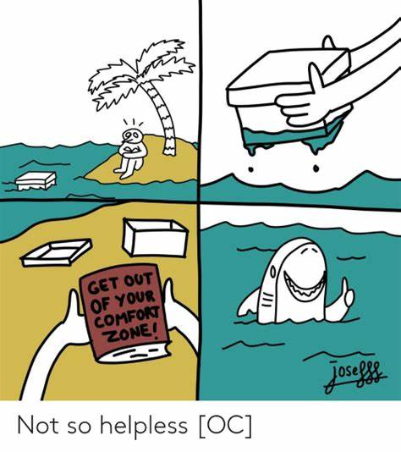
Think Before You Go
What is wrong with
staying in your comfort zone?!

Slide 19
Your Homework
Analyze the Tip 1 and Tip 2 and make a mind map;
Are those 2 tips convincing to you? If not, modify them;
Brainstorm the issue in “Critical thinking”;

Slide 20
Thank You!
Class
Dismissed

