Slide 1
01
Teaching Design
Contents
02
Demo Class

Slide 2
Contents
01
Teaching Design

Slide 3

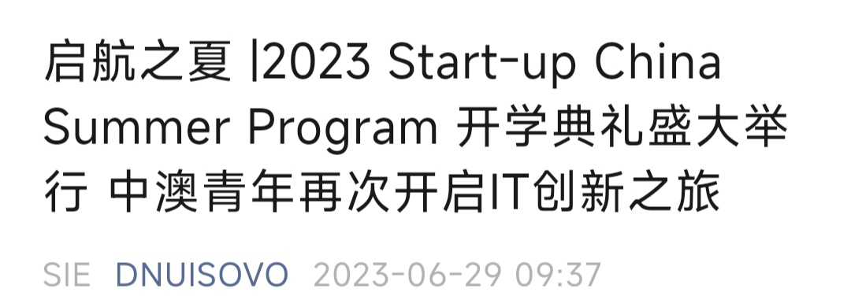

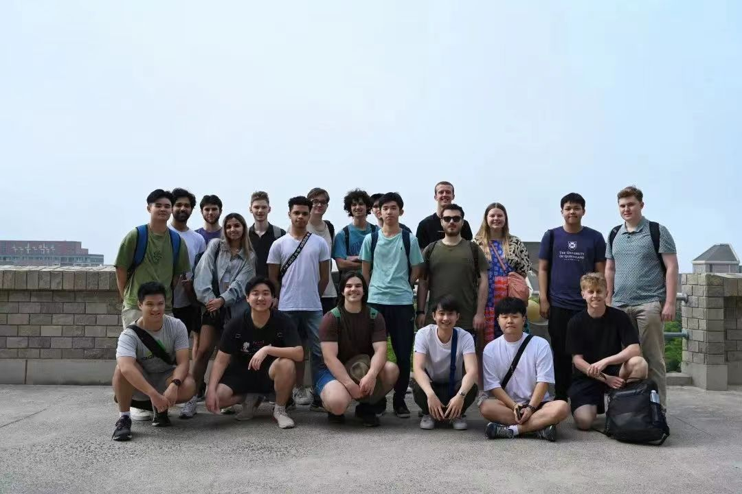
Target Students
Freshmen, first semester, E-commerce major
L3-L4 (CSE)
Digital Natives, Application & Professional Skills
Projects at SOVO (Project-oriented base for innovation & practice)

Slide 4


Slide 5
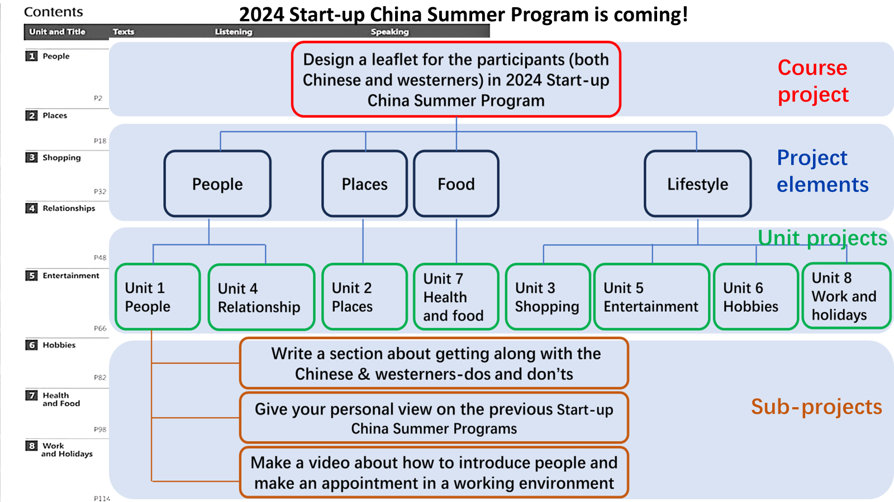

Slide 6
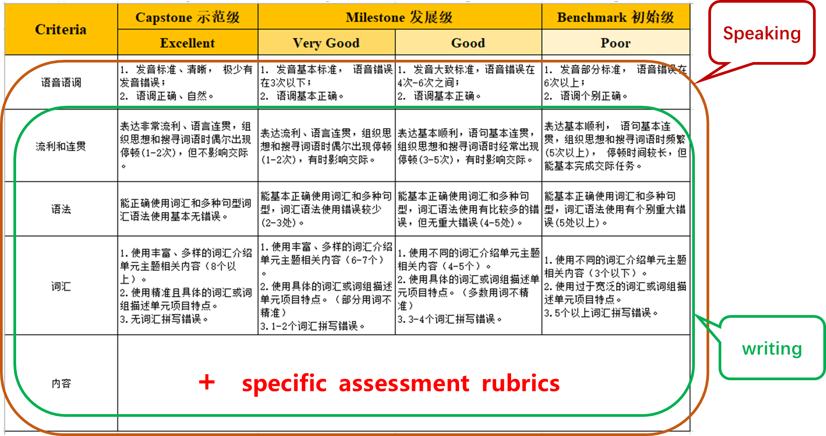
Project Evaluation Criteria
Writing

Slide 7
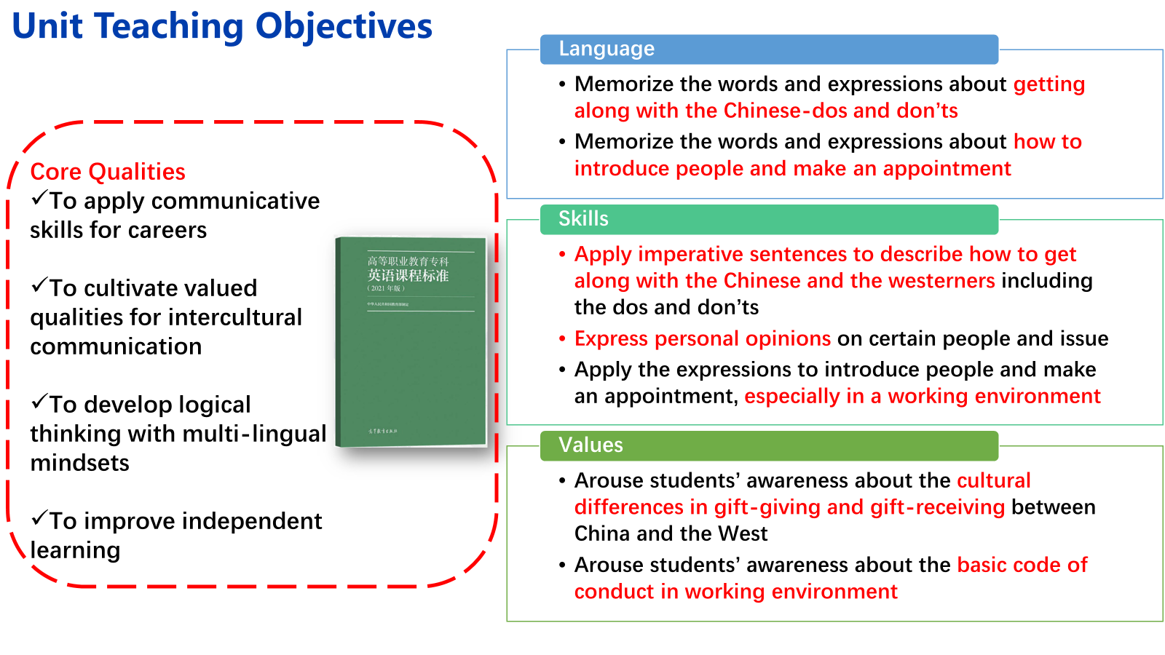

Slide 8
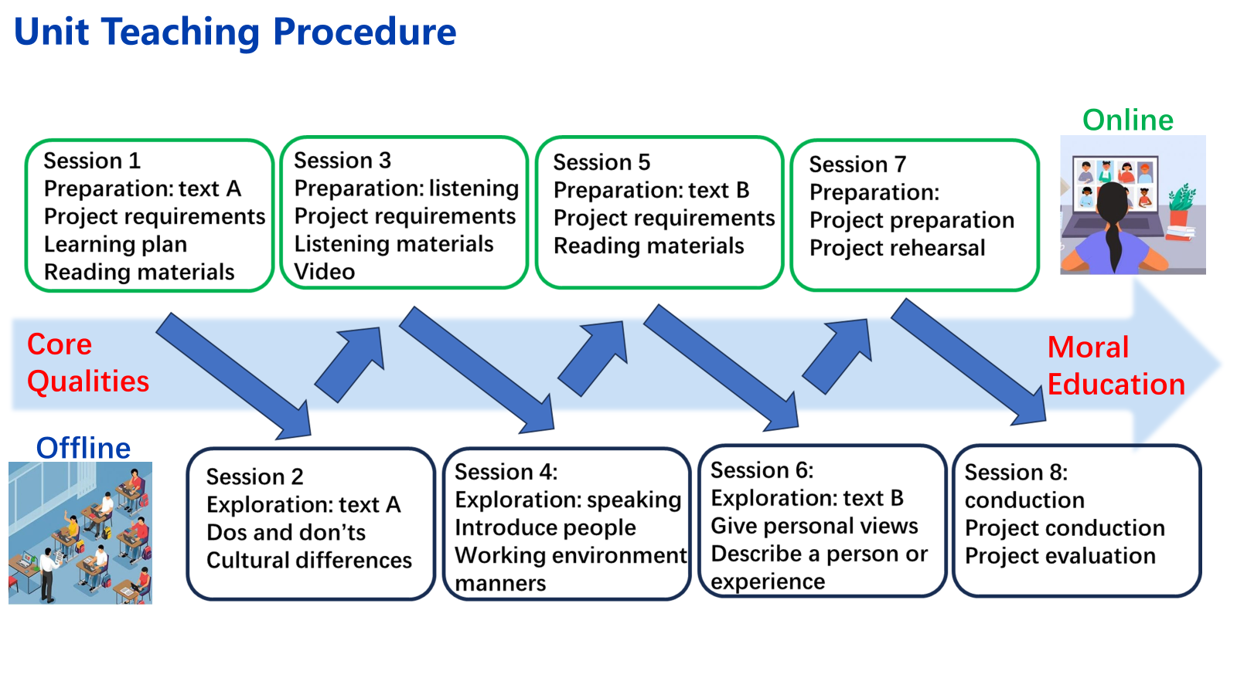
Demo class
demonstration

Slide 9
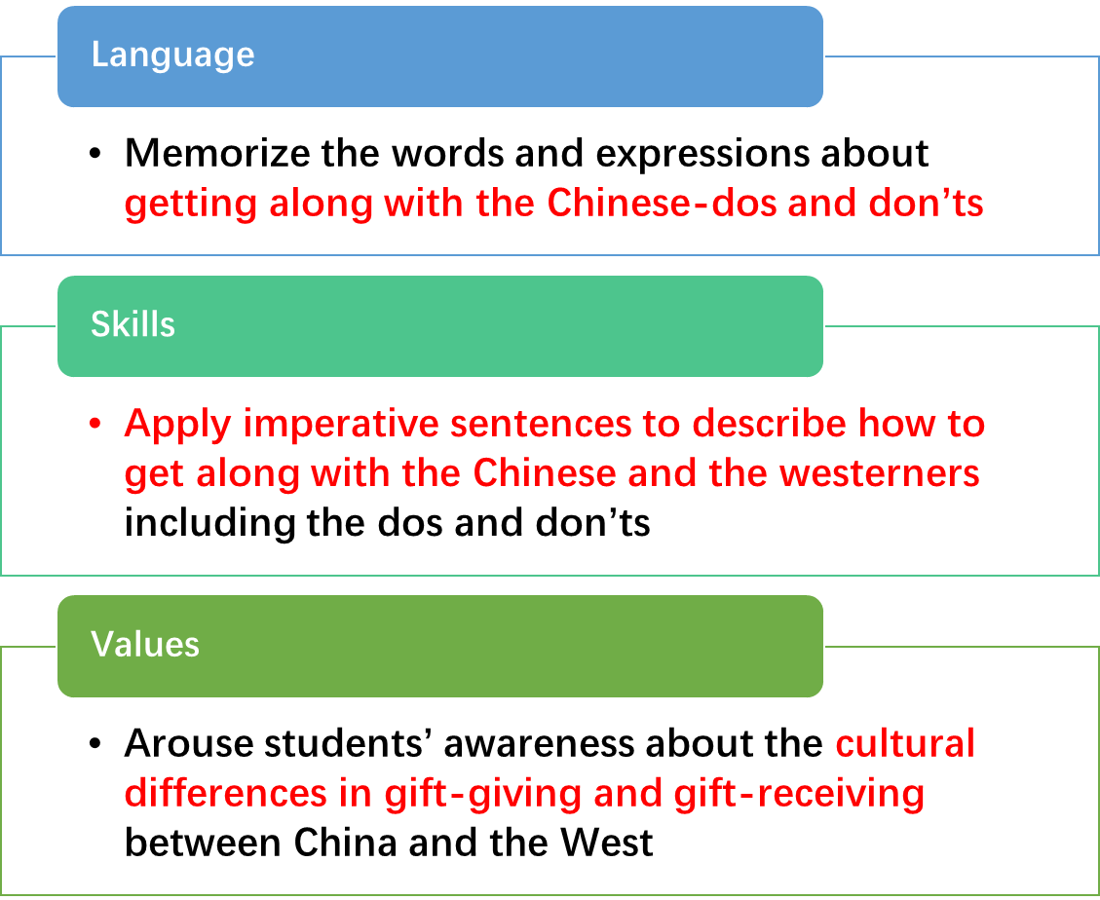
Teaching Objectives of the Demo
Key point
Difficult point

Slide 10
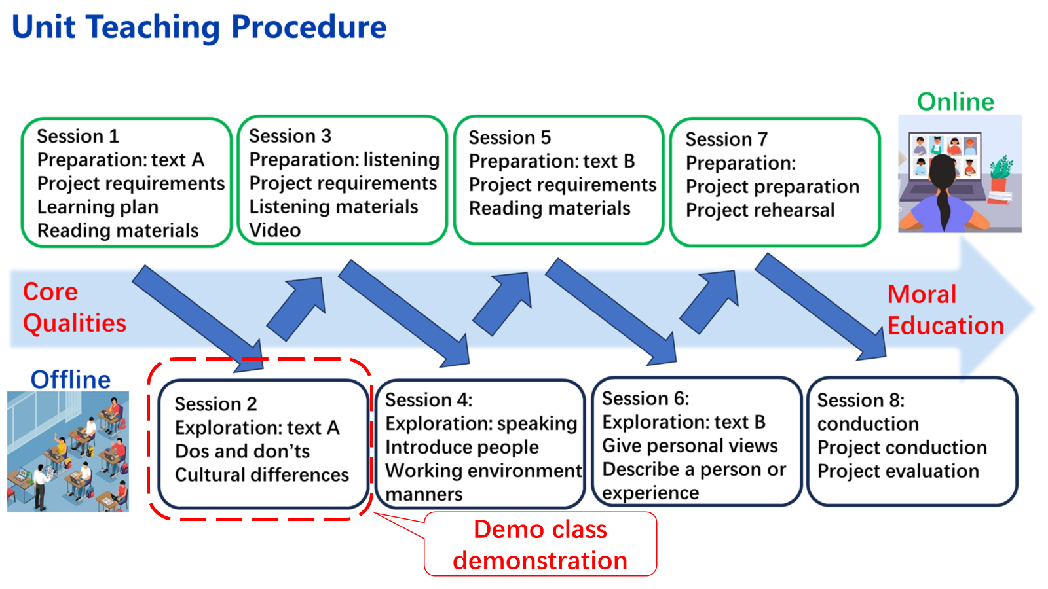
Demo class
preparation

Slide 11
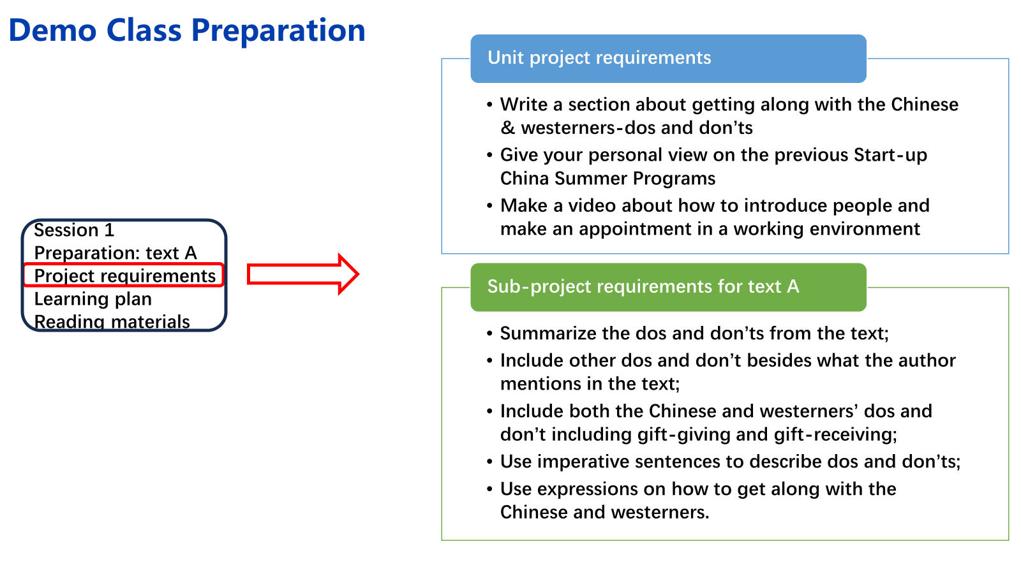

Slide 12
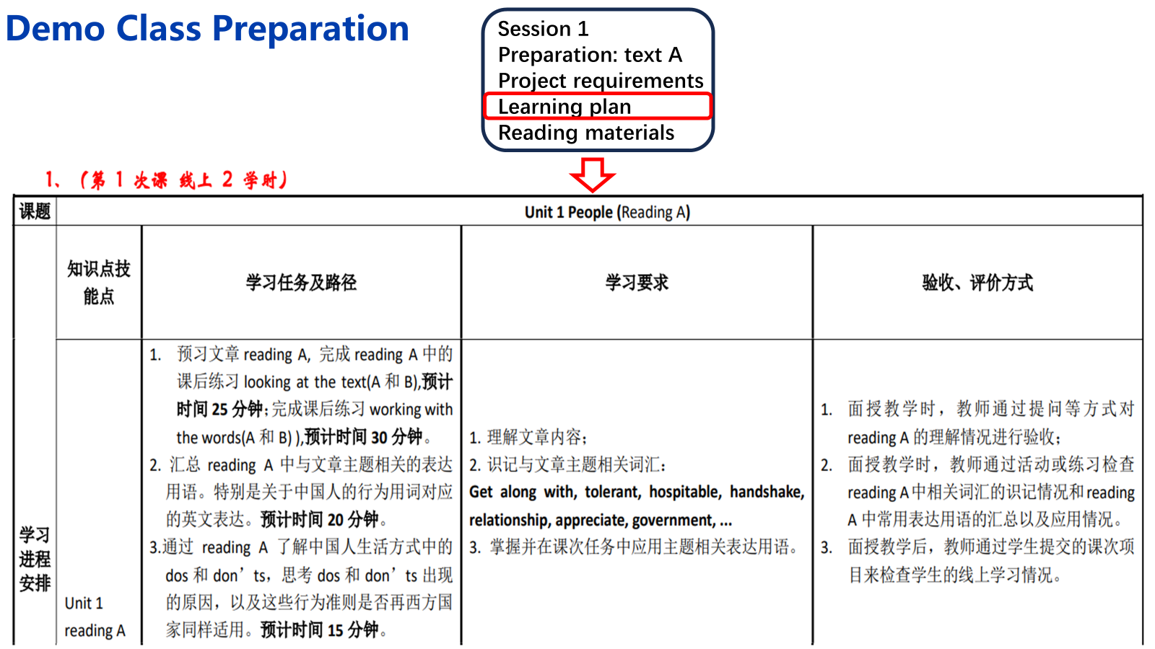

Slide 13
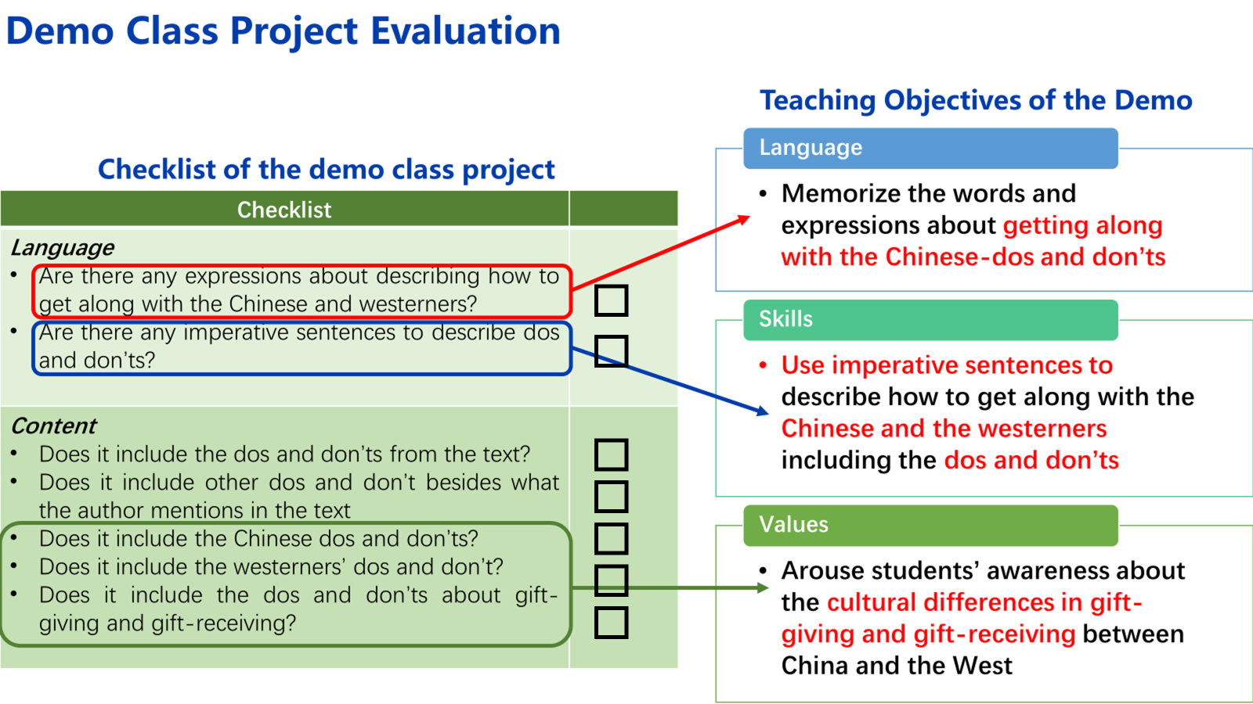

Slide 14
Contents
Demo Class
02

Slide 15

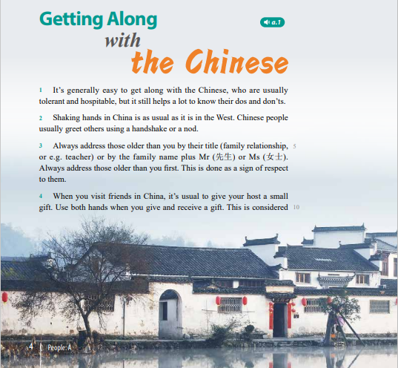
Use one word to describe your deskmate.

Slide 16


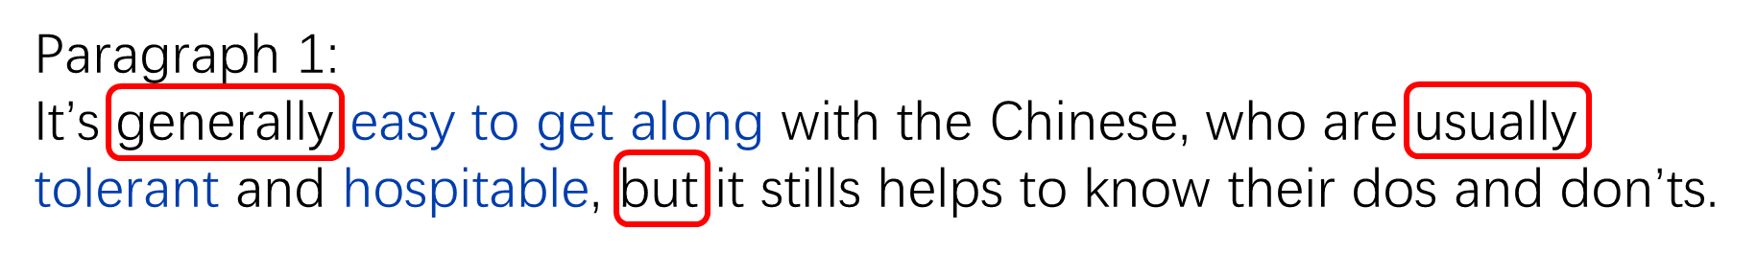
What are the Chinese people like in the author’s eyes?
easy to get along with
tolerant
hospitable
Does the author mean we are easy to get along with, tolerant and hospitable all the time?
Focus: Getting Along with the Chinese-dos and don’ts

Slide 17
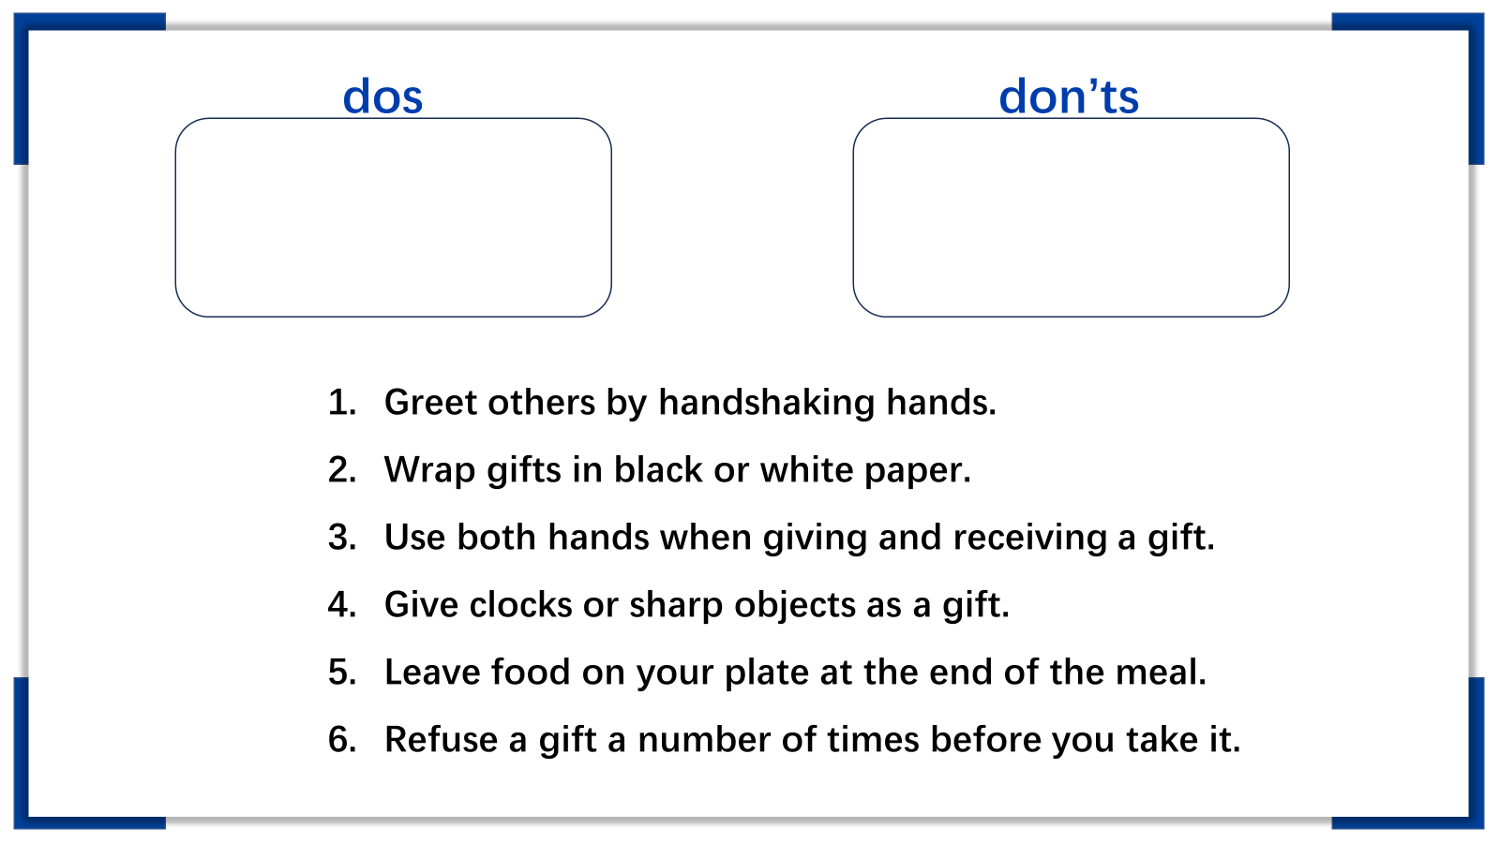
1，3，6
2，4，5

Slide 18
imperative sentence
order, request, suggestion
dos
don’ts
Greet others by handshaking hands.
3. Use both hands when giving and receiving a gift.
6. Refuse a gift a number of times before you take it.
2. Don‘t wrap gifts in black or white paper.
4. Don‘t give clocks or sharp objects as a gift.
5. Don’t leave food on your plate at the end of the meal.

Slide 19
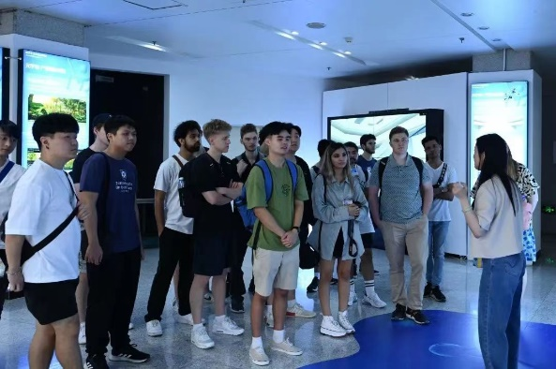


In the library

Slide 20


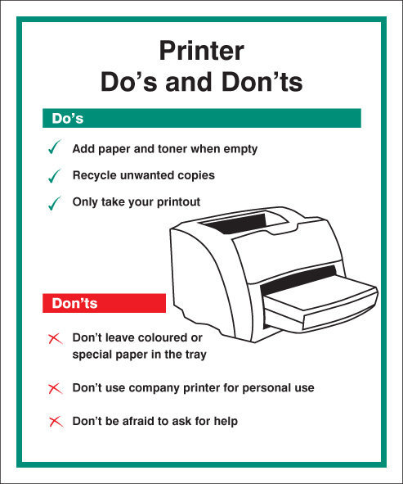
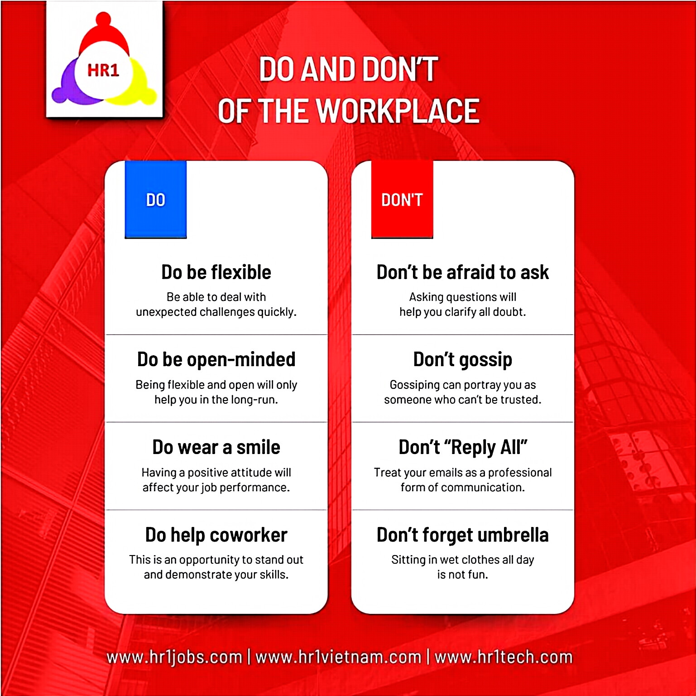
In the office
At the workplace

Slide 21

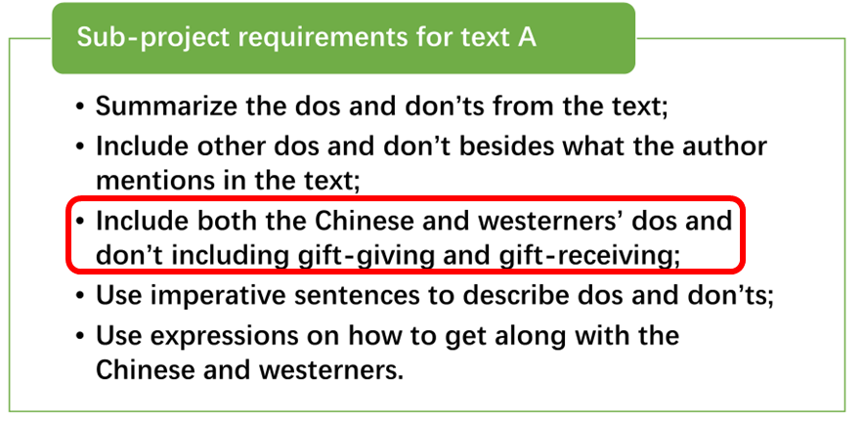
Exchange gifts
The dos and don’ts of gift-giving and receiving in Chinese ways
dos
don’ts
1. Greet others by handshaking hands.
3. Use both hands when giving and receiving a gift.
6. Refuse a gift a number of times before you take it.
2. Don‘t wrap gifts in black or white paper.
4. Don‘t give clocks or sharp objects as a gift.
5. Don’t leave food on your plate at the end of the meal.

Slide 22

Why do the Chinese use both hands and refuse a number of times when they receive gifts?
Because this is considered polite in Chinese culture.
Which colour is good to wrap gifts in Chinese culture?
Red.
What kind of gifts are Chinese people happy to get?
Small gifts like books, perfumes, sweets, and so on.

Slide 23



Summary
Getting along with the Chinese
dos and don’ts
How to describe dos and don’ts by using imperative sentences
Other occasions where people would see dos and don’ts
The dos and don’ts of gift-giving and receiving in Chinese ways

Slide 24
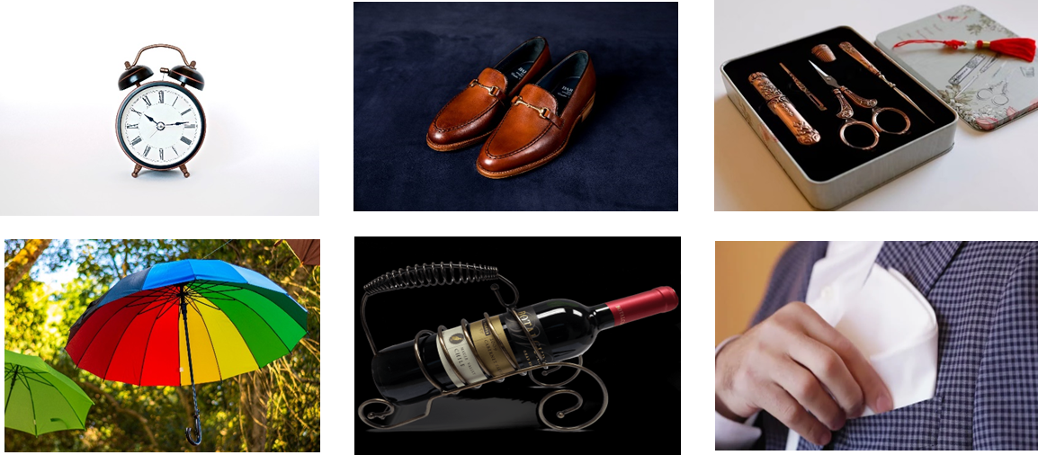
Assignment 1
1.1 Look for and summarize the dos and don’ts of gift-giving and receiving in western ways.
---the third point in the requirements of the text A sub-project
1.2 taboo gifts---match each item with its taboo meaning in certain country or culture.
Paying the last respect at someone's death.
Ending the relationship.
Giving a bad spirit/evil.
Considered harmful to bodies.
Cutting off the relationship.
Sadness and funerals.

Slide 25
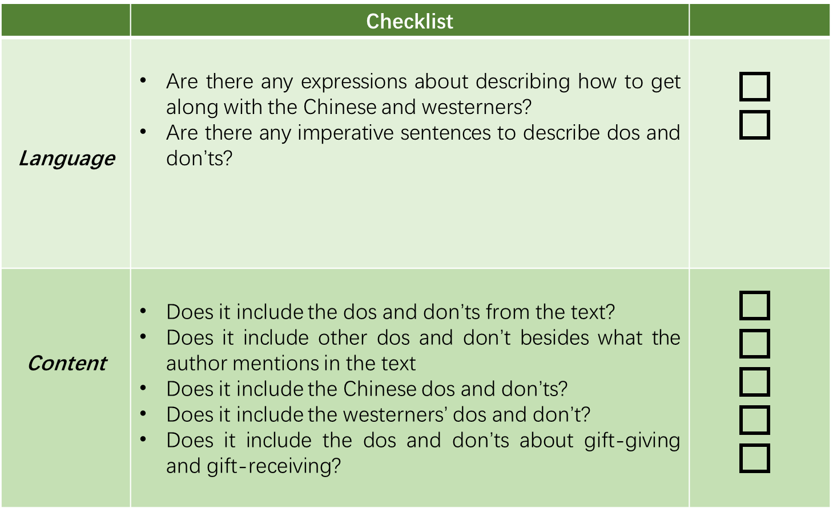
Assignment 2
Finish the sub-project for text A “Write a section of the leaflet about getting along with the Chinese & westerners-dos and don’ts”.
Requirements:
Summarize the dos and don’ts in the text;
Include other dos and don’t besides what the author mentions in the text;
Include both the Chinese and westerners’ dos and don’t including gift-giving and gift-receiving;
Use imperative sentences to describe dos and don’ts;
Use expressions on how to get along with the Chinese and westerners.

Slide 26
Thank you

