Slide 1
Teaching Design
Teaching Overview
Teaching Procedure
Demo Lesson

Slide 2
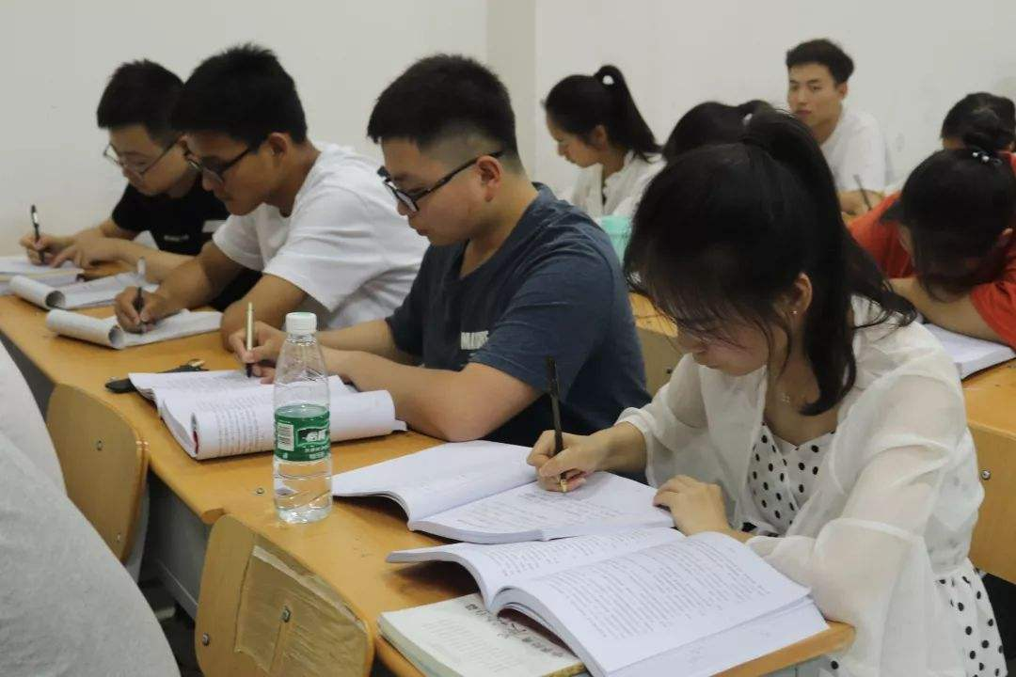
Teaching Overview
Target Students
Non-English-major freshmen
Non-English majors, sophomores
Incompetence to summarize linguistic phenomena
Lack training in using specific methods to persuade in writing

Slide 3
Teaching Overview
Teaching Objectives
Level 3
4. To express on the pros and cons of “staying in one’s comfort zone”
Awareness
Level 2
3. To master the skill of using personal experience to persuade readers in writing
Skills
Level 1
To gain basic knowledge of subheadings
To grasp the meaning and usage of key words and expressions
Knowledge

Slide 4
Teaching Overview
Teaching Approach
Learn the use of subheadings and personal experience
Practice writing a composition using them
Express more freely on relevant topic
01
The integrated process of the input and output of language
Analyze the text through various content-related tasks
02
Task-based language teaching
Before-class tasks on online learning platform
Online writing evaluation
After-class MOOC watching
03
Blended learning
These approaches are interlinked, creating a student-centered learning atmosphere to achieve active learning and better involvement.

Slide 5
Teaching Procedure
Text A Reading
Language build-up and reading appreciation
Comprehensive language practice
(1 period)
(2 periods)
(1 period)
Through tasks:
Text organization
Writing skill
Solve language difficulties
Appreciate rhetorical devices
Language practice from various perspectives
Text B Autonomous learning check
Writing demonstration and evaluation
(1 period)
(1 period)
Content questions
Review of subheadings
After-class exercises
AI evaluation
Teacher evaluation
Peer evaluation

Slide 6
Teaching Procedure
Text A Reading
Language build-up and reading appreciation
Comprehensive language practice
(1 period)
(2 periods)
(1 period)
Through tasks:
Text organization
Writing skill
Solve language difficulties
Appreciate rhetorical devices
Language practice from various perspectives
Text B Autonomous learning check
Writing demonstration and evaluation
(1 period)
(1 period)
Content questions
Review of subheadings
After-class exercises
AI evaluation
Teacher evaluation
Peer evaluation

Slide 7
Demo Lesson
Text A Reading
(1 period)
Key point: personal experience in persuasive writing
Difficult point: summarize the basic knowledge of subheadings
Through tasks:
Text organization
Writing skill

Slide 8
Demo Lesson
01
Lead-in with students’ personal experience of “uncomfortable zone”
02
Learn about main idea through subheadings
Knowledge objective
Demo Lesson
1st period
Prepare Ss for the following lessons
03
Integration of input & output; TBLT
Detail exploration—using personal experience to persuade
Skill objective
04
Discussion—The Pros and Cons of Staying in one’s Comfort Zones
Awareness
objective

Slide 9
Stepping Out of Your Comfort Zone
Text A Five Professional Development Tips for College Students
--by Josh Frahm

Slide 10
Stepping Out of Your Comfort Zone
comfortable
a situation where you feel ____________, _____ and completely at home
safe
Text A Five Professional Development Tips for College Students
--by Josh Frahm

Slide 11
Lead-in
As freshmen, compared with life in high school, is there anything in college life that makes you feel uncomfortable about?
Lose direction
At a loss

Slide 12
Stepping Out of Your Comfort Zone
Text A Five Professional Development Tips for College Students
--by Josh Frahm
Main idea prediction:
five pieces of _________ from an __________ for college students to ____________ themselves
advice
expert
improve

Slide 13
Learning Objectives
Level 3
To express on the pros and cons of “staying in one’s comfort zone”
Awareness
Level 2
To master the skill of using personal experience to persuade your readers
Skills
Level 1
To learn about the five tips through subheadings
Knowledge

Slide 14
To learn about the five tips through subheadings

Slide 15
5 tips
1. Understand and Admit Your Weaknesses
2. Research, Read, Be Aware
3. Get Out of Your Comfort Zone
subheadings
4. Diversify Your Experience
5. Stop Waiting for Things to Happen, Make Them Happen
What features do they have in common?

Slide 16
5 tips
subheadings
Features:
In bold
With numbers
With a blank line after previous content
Definition:
The heading of a subsection of a text
Format:
A word, phrase, or sentence
Clearer to present organization
Easier to draw attention
Quicker to grasp main idea of each part
Functions:

Slide 17
5 tips
subheadings
Writing:
Try to summarize
Keep in consistent grammatical form
Make the subheadings parallel with each other
TEXT A
TEXT A
TEXT B
1. Understand and Admit Your Weaknesses
1. Understand and Admit Your Weaknesses
1. It emboldens you to take more risks.
1. Understand and Admit Your Weaknesses
2. To Research, Read, Be Aware
2. Research, Read, Be Aware
2. It brings a change in perspective.
2. Face Your Weaknesses and Take Action
3. You Should Get Out of Your Comfort Zone
3. Get Out of Your Comfort Zone
3. It broadens your horizons.
3. Develop Yourself Actively
4. Diversifying Your Experience
4. Diversify Your Experience
5. Stop Waiting for Things to Happen, Make Them Happen
5. Stop Waiting for Things to Happen, Make Them Happen

Slide 18
Text A Five Professional Development Tips for College Students
--by Josh Frahm
Main idea prediction:
five pieces of _________ from an __________ for college students to ____________ themselves
advice
expert
improve
To convince/persuade

Slide 19
To master the skill of using personal experience to persuade your readers

Slide 20
Use of Personal Experience
Para. 9-11
set new goals;
find new purposes
methods
“with practice
and experience”
“take action”
“force”
COMFORT ZONE
FEAR
ZONE
LEARNING ZONE
DEVELOPMENT ZONE
credible
persuasive
purpose
(comfortable & safe)
“extremely nervous” about public speaking
“learn about yourself and develop new interest”
“be teaching students in a classroom setting”
benefits
realize dreams

Slide 21
To express on the pros and cons of “staying in one’s comfort zone”

Slide 22
Group Discussion
Topic: The Pros and Cons of Staying in one’s Comfort Zones
Summarize in the form of SUBHEADINGS and briefly explain

Slide 23
Assignment
Pick a side, write 3-4 subheadings and choose one to develop into a complete paragraph (or paragraphs). Use your own experience to be more persuasive. Please hand it in on pigai.org.
2. Watch a MOOC after class, summarize other skills in persuasive writing.

Slide 24
Thank you
for listening

