Slide 1
Notes:
Overview. 然后detail

Slide 2
Teaching Design
Non-English major
Target Students
Intermediate level
Awareness
Teaching Objectives
Task-based
Language
Teaching
Skills
Knowledge

Slide 3
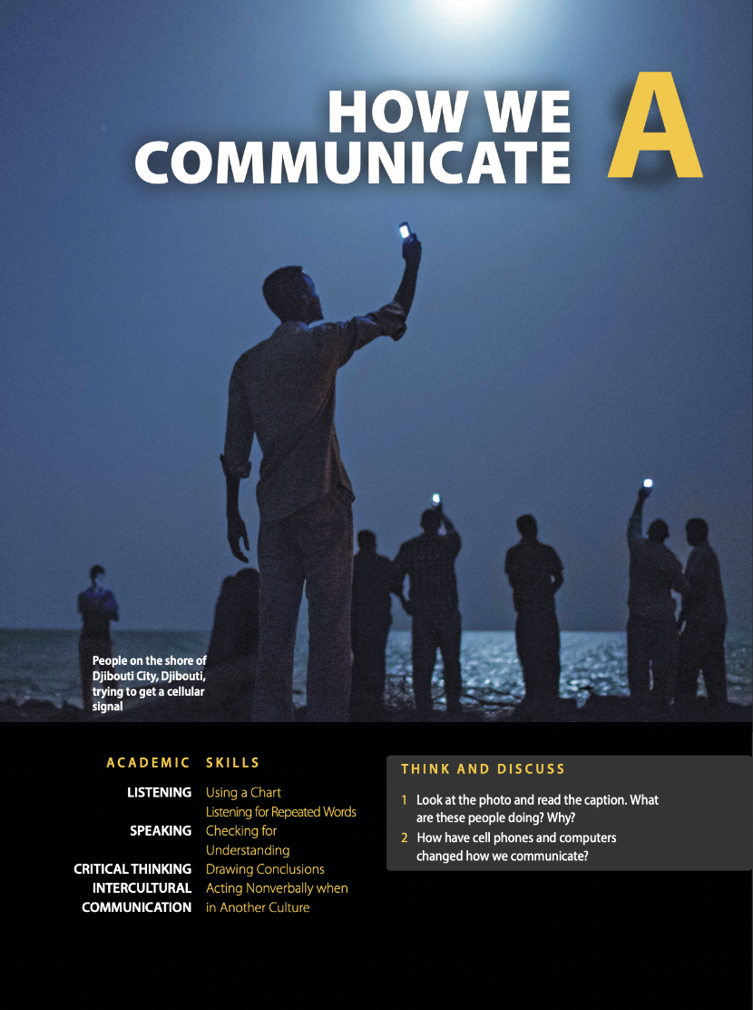
Teaching Design
HOW WE COMMUNICATE
Lesson A: A Lecture about Gestures
Listening: Importance of gestures
90 mins
Speaking: Gestures across cultures
Lesson B: Communication Software
Listening: Communication software
Speaking: Smartphone overuse
Using
examples
45 mins
Repeated
words
Extended Listening: TED Talk (Gestures)

Slide 4
Teaching Design
Before Listening
Discussion; activities related to gestures & communication software
Preparation
c. Practice speaking skills
While Listening
b. Listen for examples & repetition
Input
a. Listen for gist
After Listening
Speaking exercise; presentation
(In-class & after-class assessment)
Output

Slide 5
Teaching Objectives
Skills: Identify examples and repeated words in listening; express views with examples or by repeating key words.
Knowledge: Understand and illustrate the importance of gestures and communication softwares after listening.
Awareness: Demonstrate cross-cultural communication awareness; reflect and explain the overuse of smartphone.
Notes:
射靶

Slide 6
Demo Class
HOW WE COMMUNICATE
Lesson A: A Lecture about Gestures
Listening: Importance of gestures
Extended Listening: Ted Talk (Gestures)
Speaking: Gestures across cultures
Lesson B: Communication Software
Listening: Communication software
Speaking: Smartphone overuse

Slide 7
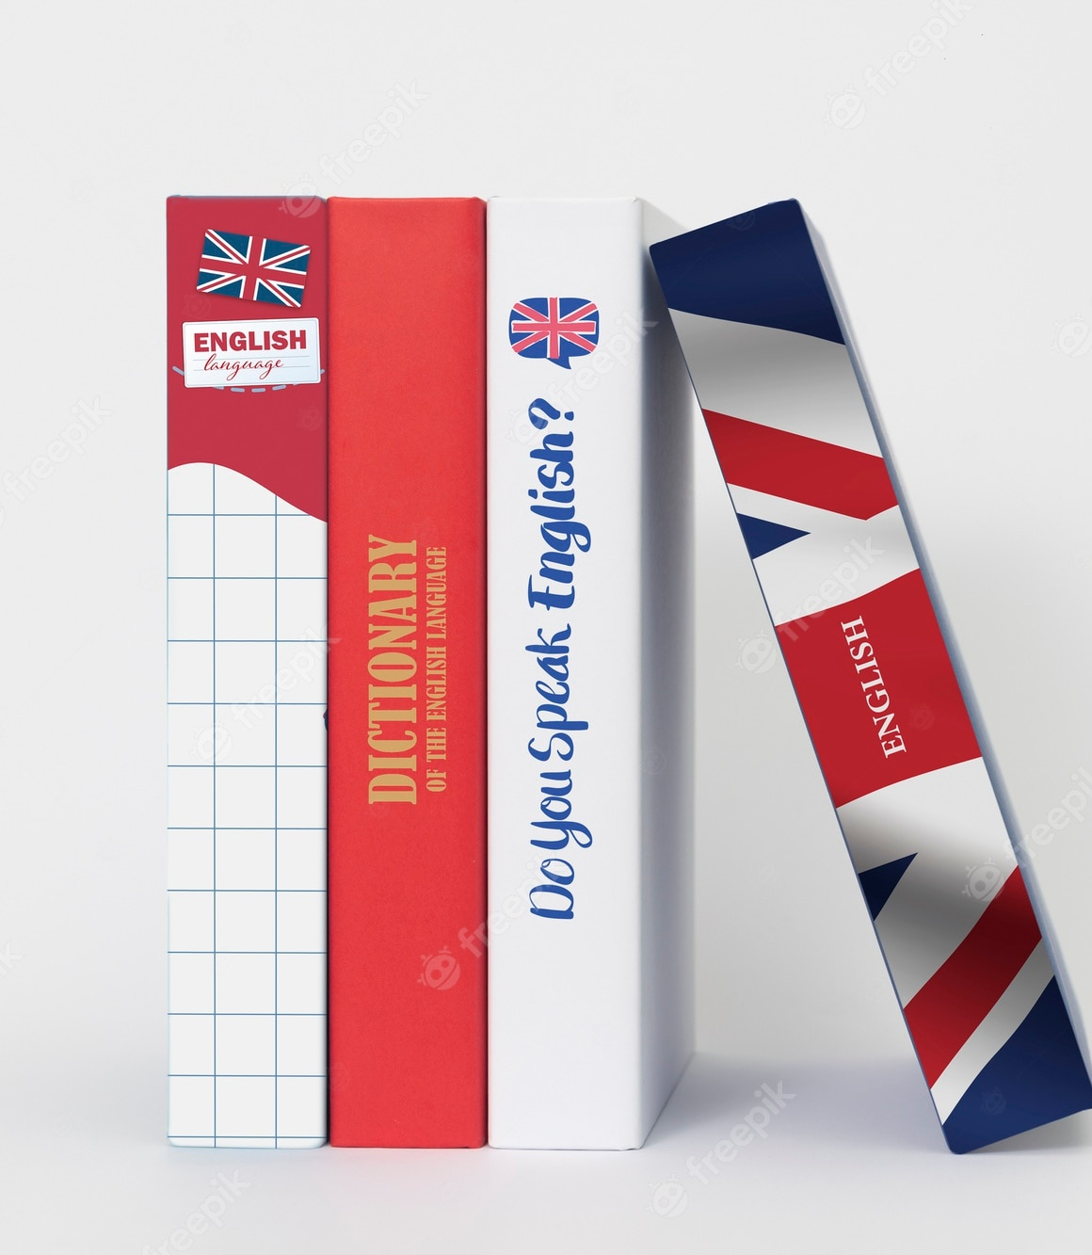
Lead-in

Slide 8
Lesson A
Gestures

Slide 9
Exercise A-Listen for Gist
T1: What is this lecture mainly about?
What gestures are and why they are important.
T2: True or false?
1. Gestures are movements that express an idea or meaning.
2. Gestures are equally important in all cultures.
3. Gestures cannot help listeners communicate.
4. Gestures help speakers remember information.
T
F
F
T

Slide 10
Exercise B-Listen for Details
Italians
 | For example, experts believe that _________ know and use about ______________________ on a regular basis.
 | If you're in a __________________ and someone asks you a question, you can _____________________________to say, I'm sorry, I don't know.
 | If they make or even see a gesture while hearing a story, making the gesture again can help them _________________________________of the story.
250 hand gestures
foreign country
shrug and lift your hands
recall vocabulary and details

Slide 11
Exercise B-Listen for Details
Italians
 | For example, experts believe that _________ know and use about ______________________ on a regular basis.
 | If you're in a __________________ and someone asks you a question, you can _____________________________to say, I'm sorry, I don't know.
 | If they make or even see a gesture while hearing a story, making the gesture again can help them _________________________________of the story.
250 hand gestures
Gestures are more important in some cultures.
foreign country
shrug and lift your hands
Gestures can help listeners communicate.
recall vocabulary and details
Gestures help speakers remember information.

Slide 12
Structure Analysis
Main points
Examples
What gestures are:
· Movements that express meaning
· More important in some cultures
Italians use more gestures
Why they are important:
· Help listeners communicate
· Help speakers communicate
Listeners shrug and lift hands
Speakers recall story details

Slide 13
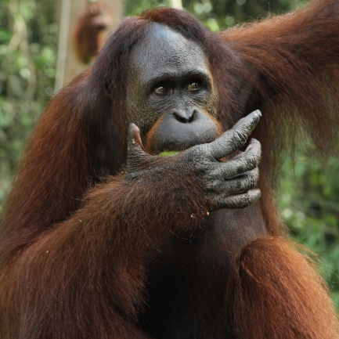
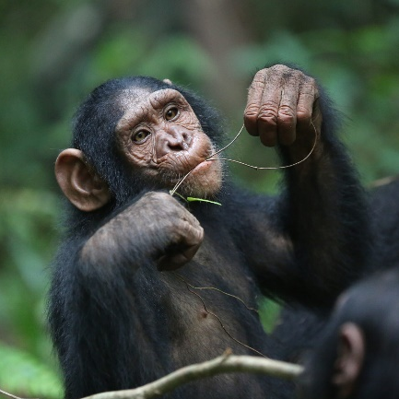
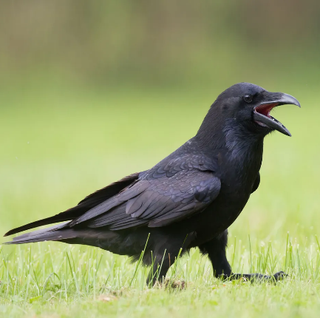
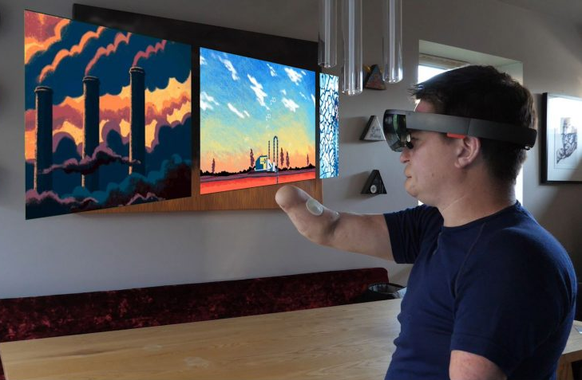
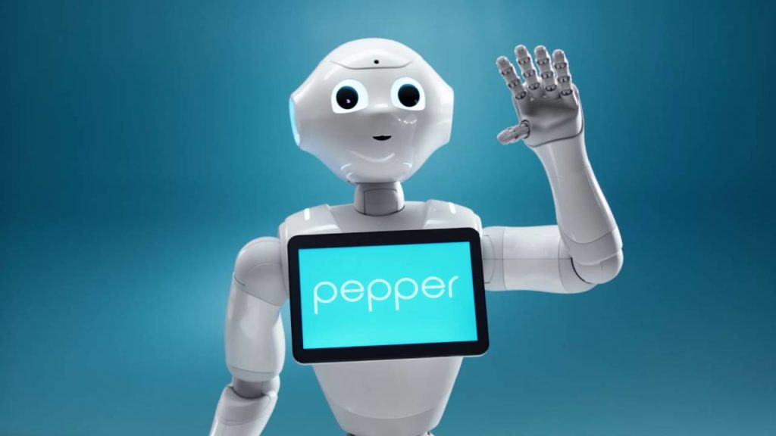
Exercise C-Using Examples in Sentences
Gestures are important to ____________.
animals
Orangutans
Bonobos
Ravens
Gestures work with _______________.
technology
Computers
Robots
______________
___________

Slide 14
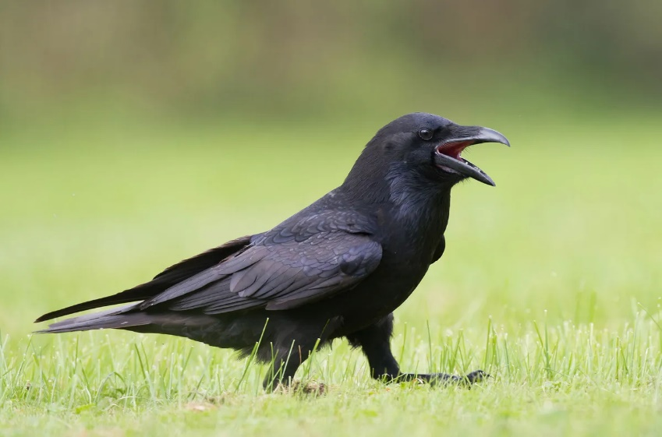
Exercise C-Using Examples in Sentences
Gestures are important to animals.
For example…
For instance…
Take…as an example…
· Ravens gesture with their beaks.
· Ravens use their beaks to communicate.
Beak
Ravens
Make a statement
Use signal words
Organize the example

Slide 15
Exercise C-Using Examples in Sentences
Gestures work with technology.
Robots,
gestures, people
Computers,
gestures, the disabled
Make a statement
Use signal words
Organize the example

Slide 16
Exercise D: Express Views with Examples
Shrug and lift hands
Gestures are important:
Help listeners communicate
Help speakers remember
Help animals communicate
Help robots communicate
Recall story details
Ravens gesture with beaks
Use movements to be better understood
Signal words: First, second, besides, moreover…
For example, for instance, take…as an example…

Slide 17
In-Depth Thinking
Gestures are used all over the world.
But their meanings differ from culture to culture.

Slide 18
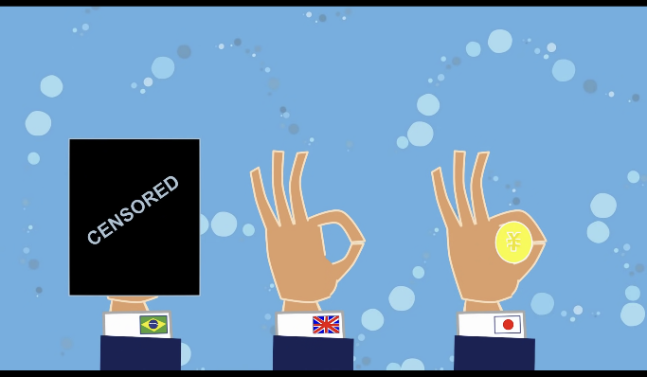
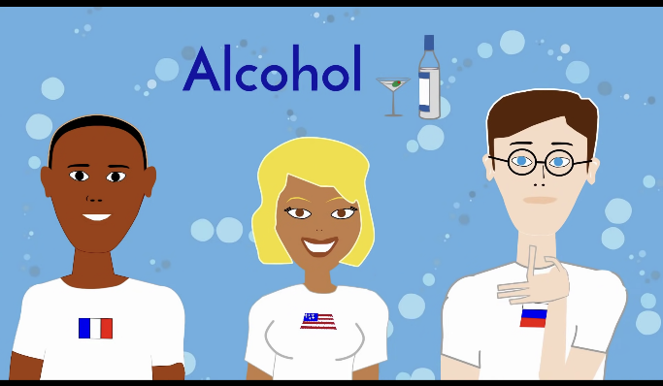
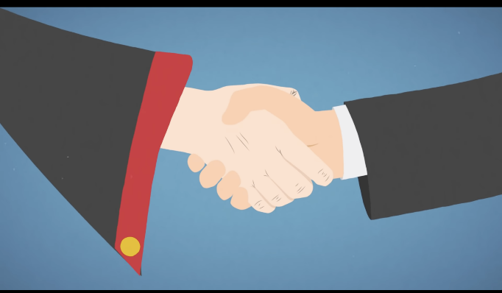
Assignment
Do your own research about different meanings of gestures in Chinese and other cultures.
Work in groups and present a stage play about using gestures in intercultural communication.

Slide 19
Thank You

