Slide 1
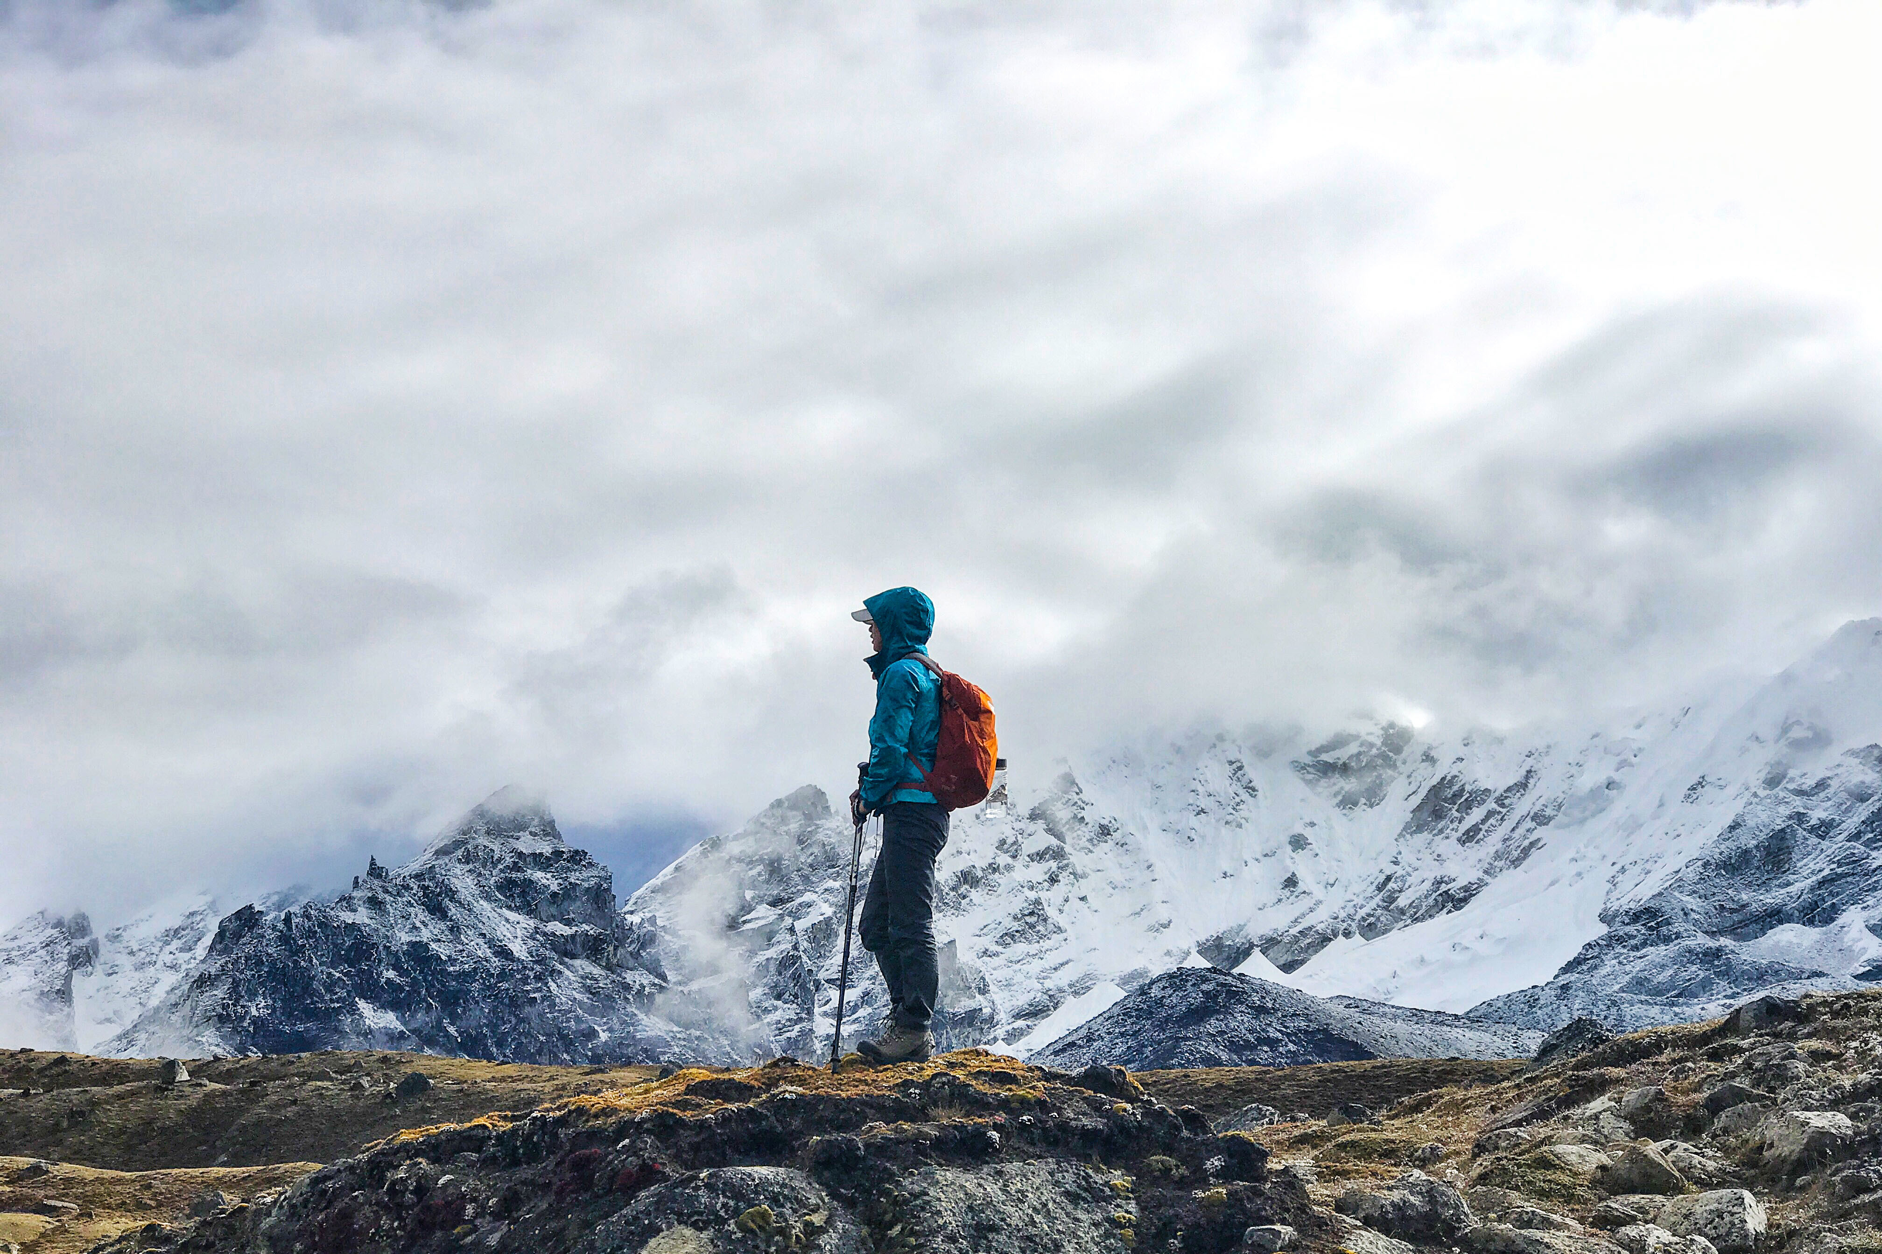
Adventure and Exploration

Slide 2
Course Design
01
Teaching Objectives
02
Target Students
03
Teaching Methods
04
Teaching Procedures
Notes:
First of all, please allow me to..., which is composed by four parts.

Slide 3
Course Design
Teaching Objectives
Teaching
Objectives
Knowledge
Ability
Value
1. Writing
Stories
2. Diction in
Description
1. Conflicts in
Stories
2. Five Senses
1. Spirit of
Exploration
2. Harmony
Between Man
& Nature
Notes:
are consist of three levels. The first one is knowledge. By the reading the text, students will learn how conflicts drive a narrative, and how to incorporate five senses in writing. The second is ability. Students will know how to develop a story and realize the importance of diction in description. in what situation, the words/grammar can be used. And the last one is students’ value. Students will be encouraged to explore the world, but at the same time they are also reminded that they should keep the harmony between man &nature.

Slide 4
Course Design
Target Students:
Non-English Majors
Sophomore Students
Chinese Story Tellers: written words; videos; speeches
Notes:
Many of them not only tell stories in written words. They can make videos, deliver speeches. But first of all, they need to know what make a good story.

Slide 5
Course Design
Teaching
Methods
Task-based Teaching
Blended Teaching
To write a story for Campus Daily Official Account (Wechat)
Online preview:
Texting reading;
New words learning...
Notes:
It’s a combination of TBT and BT. Students will need to do preview, with the help of online courses. and their task of the whole unite is to To write a story for Campus Daily Official Account (Wechat). We’ll publish good stories written by our students.

Slide 6
Course Design
Step 1 Hiding the conflicts in settings
Lead-in:
Set a background
Reading:
1. How troubles drive a narrative?
2. How to use five senses (&
proper words)
Task: Story Writing
Step 2 Developing the conflicts
Discussing:
Themes & values showed in the conflict
Step 3 Resolving the Conflicts
Notes:
Students will be driven by the task and learn how to write a story by the following three steps.... Step1, here they will learn how to set a background for stories.. learn proper words that can be used in sense description

Slide 7
Course Design
Teaching Procedures
 | Procedures | Interaction Patterns | Content
Pre-task | Students’ Preview Online | Individual Work | Text Reading; New Words
 | Lead-in (10 mins) | Full-class Interaction | Settings; Story Elements
 | Reading the Passage (80 mins) | Jigsaw Grouping; Dicussion | How did the writer set, develop and resolve conflicts in the story?
Task | Writing Task (Assignment) | Individual Work | Writing Stories
Post-task | Task Presenting (30 mins) | Presentation | Presenting Stories
 | Students & Teacher Feedback (20 mins) | Discussion | Evaluation; Problems;
 | Grammar & Exercises(40 mins) | Monologue | Grammatical Mistakes
Notes:
As for teaching procedures, as you can see. students will do preview online. During the class, there will be a 10min lead-in,and then we will analyze the text to find out how does th writer set, develop and resolve conflicts in the story. Then they go back to do their writings. They will need to present their stories in next class. Both students and teachers will give evaluations and common language problems will be explained by the teacher.

Slide 8
01
Lead-in
Contents
02
Reading
03
Discussion
04
Assignment
Notes:
Now let’s get the class started.

Slide 9
01
Lead-in

Slide 10
Please select your protagonist.
Lead-in
Your choice will lead to different story settings.
Notes:
Since you are gonna write a story, you should have a protagonist. So here you can select your protagonist. But be careful, your choice will lead to ....

Slide 11
Your protagonist is ____.
Lead-in
A. a commander
B. an engineer
C. a geology student

Slide 12
Your protagonist is ________.
Lead-in
Zheng He
In 1405, he commanded the largest fleet in the world, carrying valuable gifts to the countries he had never been before.
A. a commander
Are there any clues that indicate potential conflicts?
Notes:
Well, the setting is simple, just one sentence. But can you find any potional conflicts in it? Carrying valuable gifts to unknown place. ..... Sounds dangerous.. BTW, his name is…

Slide 13
Your protagonist is __________.
Lead-in
Zhan Tianyou
In 1911, the Chinese engineer was pointed to build a railway without other countries’ technical help.
B. an engineer
Are there any clues that indicate potential conflicts?
Notes:
So did he manage to do it? His name is ….

Slide 14
Your protagonist is ______.
Lead-in
In the Arctic, a student, with five teammates, was carrying heavy boxes of rock samples on thin ice.
C. a geology student
Are there any clues that indicate potential conflicts?
Notes:
So, did they survive?

Slide 15
Your protagonist is _____.
Lead-in
In the Arctic, a student, with five teammates, was carrying heavy boxes of rock samples on thin ice.
C. a geology student
Setting is not only about when/where/who.
Hide potential conflicts in your setting.
Notes:
So that is what I say, setting is not only about when where who, we can hide the potential conflicts in it. And when it breaks out, it won’t be too abrupt. How can a conflict break out and how conflicts develop a story? We will find it out in the text.

Slide 16
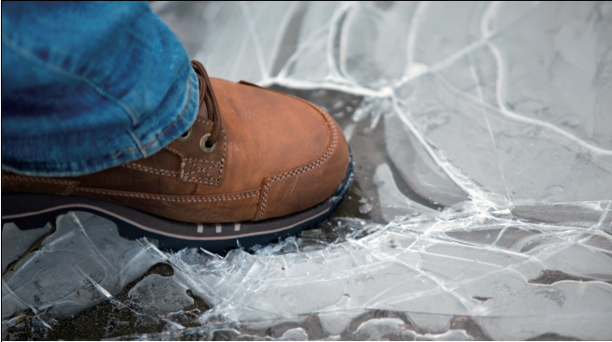
Reading: A Walk on Thin Ice
02
Notes:
Let’s go through the structure of the passage first.

Slide 17
Lead-in
Reading
Structure
Paras. 1–4 ： Setting (Potential conflicts)
Paras. 5–17: Conflicts in progress
Para. 18: The end (Conflict settled )
When: In 1965;
Who: geology students;
Where: the Arctic;
Motivation: to bring back the rock samples that can help to prove the theory of continental drift.
Q: In para. 6, “we” received bad news which triggered the conflict. What’s the bad news about?
Human: Survived;
Advanced human knowledge
Nature: Received respect
Notes:
We will go through the structure first. Para 1-4 are about the setting, conflict in suspense...Now please look at para 6, here “I” received a bad new, which triggered the conflict. What’s bad news about?

Slide 18
Lead-in
Reading
Structure
Paras. 1–4 ： Setting (Potential conflicts)
Paras. 5–17: Conflicts in progress
Para. 18: The end (Conflict settled)
When: In 1965;
Who: geology students;
Where: the Arctic;
Motivation: to bring back the rock samples that can help to prove the theory of continental drift.
Bad News: Storms had moved the pack ice into the mouth of the sound, clogging it solid. (Para. 6)
We would have to get to the boat by walking out on ice. (Para. 7)
Human: Survived;
Advanced human knowledge
Nature: Received respect
Notes:
We will go through the structure first. Para 1-4 are about the setting, conflict in suspense...Now please look at para 6, here “I” received a bad new, which triggered the conflict. What’s bad news about?

Slide 19
Lead-in
Reading
Structure
Paras. 1–4 ： Setting (Potential conflicts)
Paras. 5–17: Conflicts in progress
Para. 18: The end (Conflict settled)
When: In 1965;
Who: geology students;
Where: the Arctic;
Motivation: to bring back the rock samples that can help to prove the theory of continental drift.
A walk on thin ice
Human vs. Nature
Human: Survived;
Advanced human knowledge
Nature: Received respect
Notes:
Here it brings out the title. According to the title and the structure we’ve just mentioned, this is a conflict between who and who? .........Human and Nature. Nature is the one who gave us troubles.

Slide 20
Lead-in
Reading
Human
Nature
What troubles did the nature cause and how did the students response to them?
Group 1 | Group 2
Paras. 10-12 | Paras. 13-17

Slide 21
Lead-in
Reading
1. ...water so ____ (Para. 10), it could be ______ to anyone who might fall in.
2. There was a few inches or feet of __________ between the ice floes. (Para.11)
Having
troubles
cold
open water
lethal
1. We gave _________ for mutual encouragement, moved out onto the raft of ice. (Para. 10)
thumbs-up
2. We had to ______________________
from one chunk of ice to the next.(Para. 11)
run and jump across the water
Solving troubles

Slide 22
Lead-in
Reading
appearing
3. ...her red hull __________ dramatically ...(Para.13)
His crew waved frantically and ______ with delight.
(Para.13)
We could _____ the comforting mix of diesel smoke and kitchen.(Para.15)
yelled
smell
4. The boat and we were ______________________________________ that was a good eight feet across.(Para.14)

Slide 23
Lead-in
Reading
...her red hull appearing dramatically...
His crew waved frantically and yelled with delight.
We could smell the comforting mix of diesel smoke and kitchen.
Sight
Hearing
Smell
getting closer to the ship.
These descriptions show: 1. (physically)
2. (emotionally)
full of hope
Notes:
first, you could see the red hull, then, you could hear their yelling and then, you could smell the smoke from it. You are getting closer to the ship, you are going to make it. ... And this kind of description skill is call five senses

Slide 24
Lead-in
Reading
Five Senses
...her red hull appearing dramatically...
His crew waved frantically and yelled with delight.
We could smell the comforting mix of diesel smoke and kitchen.
Sight
Hearing
Appear: sth./sb. move into a position where you can see it.
(When you want to describe “sight” in writing)
I see sth. = sth. appears
e.g.: Her red dress appeared at the far end of the street.
Similar: come into sight; come into view; emerge; arise; crop up;
Smell
You stepped onto it and it bowed under your weight, ...
Touch
My mouth is on fire.
Taste
Notes:
what you need to be noted is that..touch is about more than the way things feel in your hands, it can be used to describe what your body feels......
You can feel how spicy it is.....
Pay attention to the word, appearing. You may know the word. But do you know it can be used to describe sight. Other than I see sth, you can also say sth appears, when it goes with color, it will be more vivid. Here we imitate the original sentence, and generate a new one.....This description shows that you’ve been waiting for her so long and you are so eager to see her....similar expressions. all of them can be used to describe “sight”

Slide 25
Lead-in
Reading
Five Senses
Humans rely on senses to perceive the world. And words have the power to connect to your senses.
1. Don't simply tell your readers what is going on. Describe it to
them!
2. “Why does it matter here?” -- To reveal your intention.
Notes:
Humans rely on senses to perceive the world. And words have the power to connect to your senses.
In order to use five senses in writing, here are two tips for you. Don't simply tell your reader how you feel or what is going on. Show it to them with your description.

Slide 26
Lead-in
Reading
appearing
3. ...her red hull __________ dramatically ...(Para.13)
His crew waved frantically and ______ with delight.
(Para.13)
We could _____ the comforting mix of diesel smoke and kitchen.(Para.15)
Having hope
yelled
smell
4. The boat and we were ______________________________________ that was a good eight feet across.(Para.14)
Trouble again
separated by a stretch of water
Notes:
Back to the blank filling. When everyone is full of hope, what happened? ...

Slide 27
Lead-in
Reading
Trapped in
troubles
Solving troubles
Having
hope
Troubles coming again
Conflicts: Full of twists and turns
Notes:
So you see, how conflicts develop the story:

Slide 28
Conflicts
1. The conflict is the driving force of the action.
2. How can we set a conflict in a story?
Usually, in a short story, the problem will center around the
character (e.g.: environment, motivation, gender, age...).
3. The conflicts can show the theme of your story.

Slide 29
03
Discussion
Notes:
So what’s the theme of this text? in order to answer the question, we need to have some discussions .

Slide 30
Lead-in
Reading
Discussion
Human vs. Nature?
Who had greater power?
Exploration in the Arctic:
Facing troubles:
Powerful
Indiscriminate
Unpredictable
Exploring spirit
Being brave; Supporting and encouraging each other
Notes:
Human and nature, who has greater power? Theoretically speaking, it should be nature. Yes, it’s nature. It’s indiscriminate.... What about human? What kind of power did the six students have?

Slide 31
Lead-in
Reading
Discussion
Human vs. Nature?
Who won in the conflict?
The six of us lived...
We had advanced human knowledge....
We had known all too little about Nature...now tendered her(nature) the most profound respect.
Notes:
Since human also had their power, who won in the conflict? Look at para 18, we know that at the end, ..... This is the end of the story Can you tell, who won ? Human? Why? Because they were alive and advanced human knowledge?
Is it the psychology of a winner? We had known all too little about Nature. We realized how trivial ,how vulnerable were in front of nature.

Slide 32
Lead-in
Reading
Discussion
Human vs. Nature?
The six of us lived...
We had advanced human knowledge....
Remained intact
Received respect
A tie
Notes:
Yes, it’s nature. It’s indiscriminate.... What about human? What kind of power did the six students have?

Slide 33
Lead-in
Reading
Discussion
Conflicts between human and nature end up with a tie
--A happy ending.

Slide 34
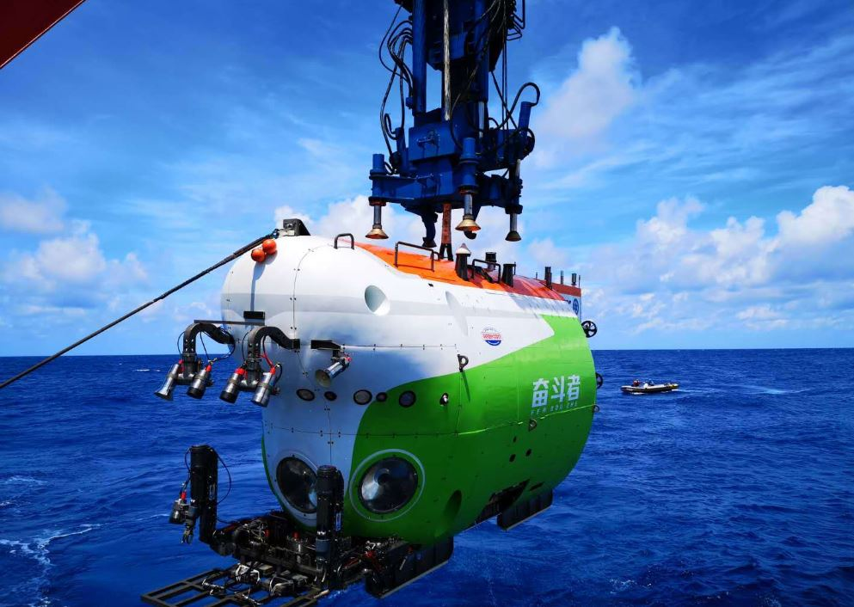
Lead-in
Reading
Discussion
China's new manned submersible Fendouzhe, or Striver, set a national diving record of 10,909 meters
Notes:
Today, we have admirable explorations, deep into the sea,we have striver, up to the space, we have Tiangong

Slide 35
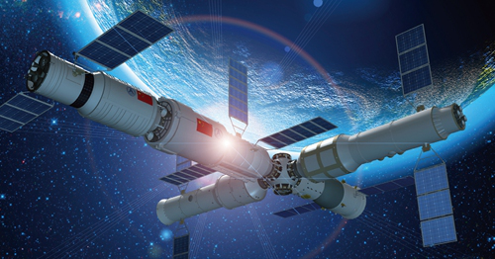
Lead-in
Reading
Discussion
Tiangong Space Station

Slide 36
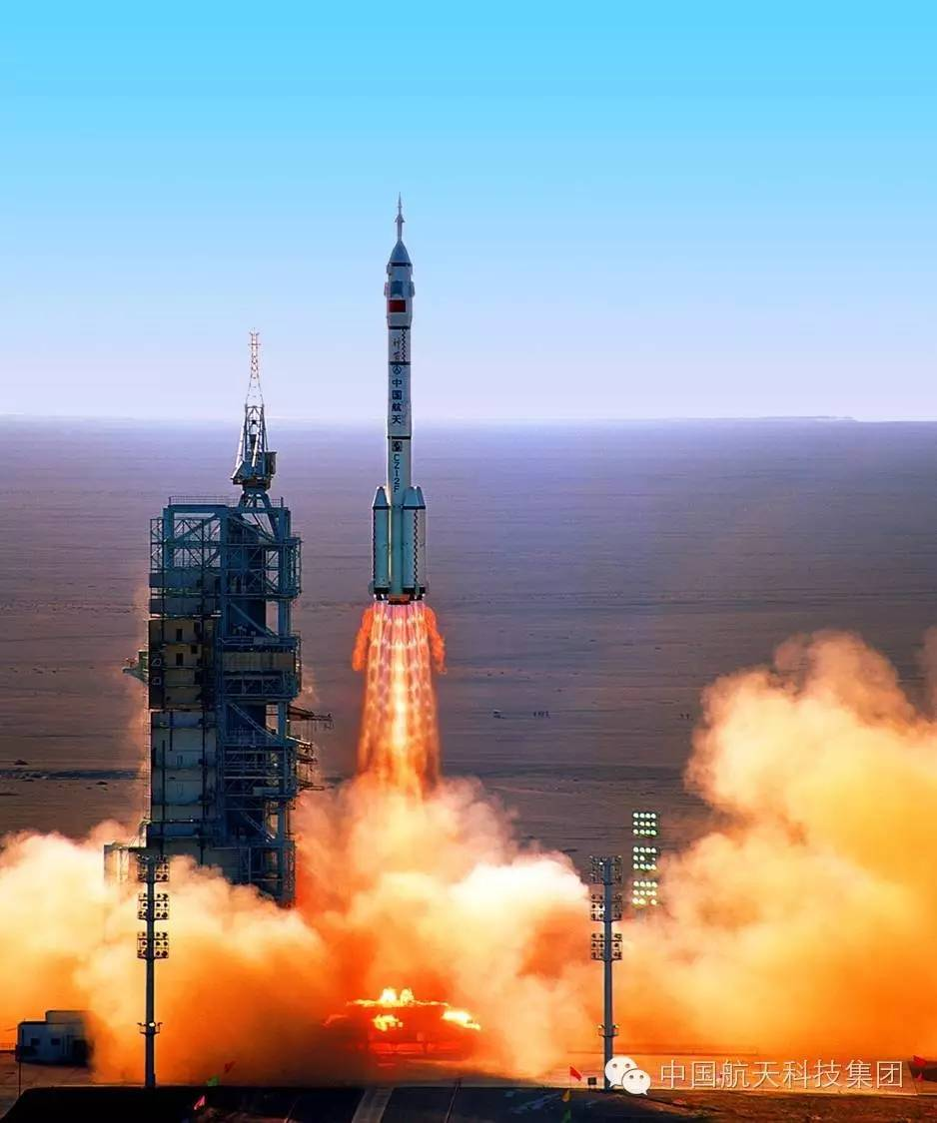
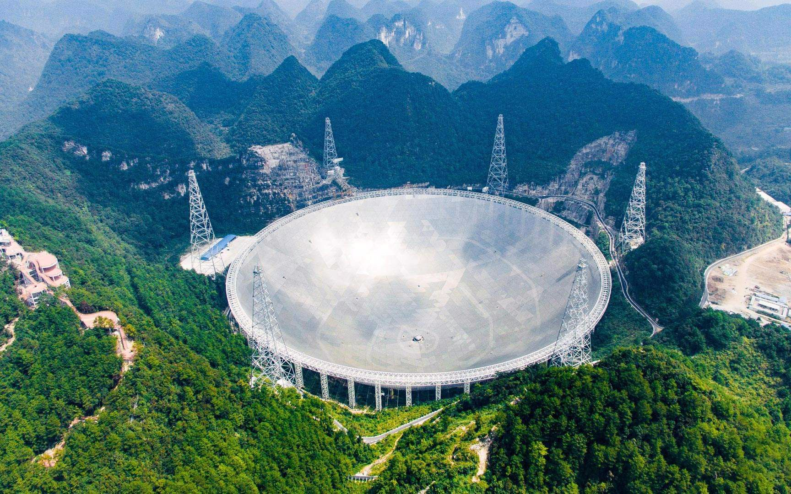
Lead-in
Reading
Discussion
Their bravery and perseverance pave the way to human development.
Notes:
Facing the unknown, our pioneers never back down

Slide 37
Strike a balance between exploration, human development and eco-system.
Lead-in
Reading
Discussion
Humans and nature are fundamentally one.
Notes:
But at the same time, we should also revere nature. and try to strike a balance between exploration, human development and ecosystem. because man and nature are fundamentally oneness.

Slide 38
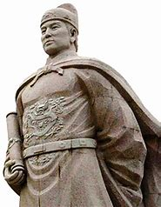
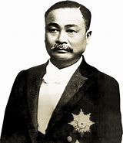
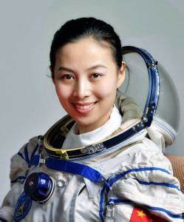
Assignment
Write a story about a Chinese (in the past/at present/in the future).
1. The story should center on a main conflict.
2. Try to incorporate five senses into your description.
(250 words)
Notes:
It can be a person living in the past, at present or even in the future

