Slide 1
Unit 1 Stepping Out of Your Comfort Zone

Slide 2
Teaching Design

Slide 3
Challenges
1. Develop genre awareness for persuasive writing;
2. Associate students’ own personal growth with the message and values given in this unit.

Slide 4
Learning Objectives
Value and Awareness
Reflect critically on their own development and embark on a successful college journey.
Awareness
Skills
Develop their persuasive genre awareness;
Learn to persuade others properly.
Skill
Knowledge
Understand the five tips of professional development for college students;
Expand theme-related vocabulary and express their own opinions on it.
Knowledge

Slide 5
Teaching Philosophy
Usage-based and Meaning-based Teaching

Slide 6
Procedures | Aims | Activities
1. Lead-in | Engage the students by activating their previous experience on the theme. | 1. Watch a video clip and fill in the blanks; 2. Share personal stories.
2. Exploration of Text A | Catch the gist of the text by analyzing its main idea, organization and language. | 1. Analyze text structure; 2. Blank-filling exercise; 3. Discussion.
3. Building Transferrable Reading Skills | Foster the persuasive genre awareness by employing “Toulmin’s Model”. | 1. Analyze the logic in the text by applying “Toulmin’s Model”; 2. Pair work: to persuade.
4. Reflection & Assignment | Reflect critically on their own personal development. | Deliver a persuasive speech on the phenomenon “Lying flat”.
5. Assessment | Output and integrate the skills learned with their learning and growing. | 1. Self/Peer/Teacher/Machine assessment; 2. Writing task & Presentation.

Slide 7
Procedures
Unit 1 Stepping Out of Your Comfort Zone
Period 1 (45 mins)
Lead-in
Exploration of Text A
Period 2 (45 mins)
Building transferrable reading skills;
Enhancement activities
Period 3 (0 min)
Assignment and autonomous learning
Period 4 (45 mins)
Presentation and assessment
Demo Class

Slide 8
demo class

Slide 9
Lead-in
The second day...
The first day...

Slide 10
Lead-in
What is a “Comfort Zone”?
a situation in which you feel comfortable and you do not have to do anything new or difficult.
(Definition of comfort zone from the Cambridge Business English Dictionary © Cambridge University Press)

Slide 11
Lead-in
What prevents us from leaving our comfort zone?
attachment
lack of determination/action
fear of failure
fear of the unknow
........

Slide 12
Five Professional Development Tips for College Students
By Josh Frahm

Slide 13
Objective
Skill
-learn to persuade properly and logically.

Slide 14
Skill building
Toulmin’s Model of Argument
Five Professional Development Tips

Slide 15
(Because)
Backing
e.g. You know that your neighbour Tom has two large German Shepherds.
Toulmin’s Model of Argument
Skill building
e.g. Dogs are animals that bark and howl.
(Since)
Warrant
(Evidence)
(Conclusion)
Grounds
Claim
You hear dog barking and howling in the distance.
There are dogs nearby.
(Strength of argument)
Qualifier
So, chances are...
(Unless)
Rebuttal
e.g. There are wolves nearby.

Slide 16
Developing job-specific skills as well as intangible skills through researching, reading and being aware are essential to reach one’s career goals.
2nd Tip
Backing
By understanding what exactly has drawn you to certain people, you can understand what skills you need.
Warrant
College students should research, read and be aware.
Grounds
Claim
One way you can take control of your own development is to emulate the people that you look up to.
Qualifier
Definitely...
Rebuttal

Slide 17
3rd Tip
Backing
Personal story.
By getting out of your comfort zone, you can learn a lot about yourself and develop interests you never thought were possible.
Warrant
College students should get out of their comfort zone.
Grounds
Claim
Many of us are afraid to stray from what is comfortable to us, but you only get better with practice and experience.
Qualifier
Definitely...
Rebuttal

Slide 18
Examples: stories of student employees and the author’s current boss.
4th Tip
Backing
The more involved you are and the more experiences you have, the better your chances of finding out what your true passion is.
Warrant
College students should diversify their experiences.
Grounds
Claim
There is no better way to enhance your own development than by diversifying your experiences while in school.
Qualifier
Definitely...
Rebuttal

Slide 19
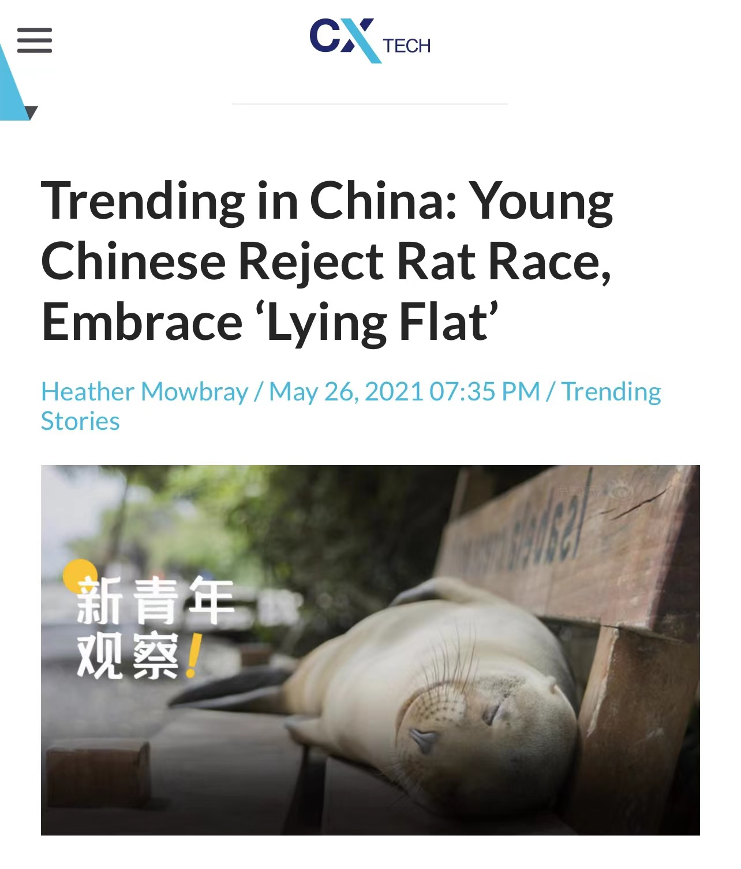
Discussion

Slide 20
Discussion
Pair work:
Could you persuade a friend of yours not to “lie flat”, but to seek challenges in college with the application of Toulmin’s Model?

Slide 21
Discussion
Backing
Warrant
College students should seek challenges.
Grounds
Claim
e.g. Only in a state of discomfort can you continually grow.
Qualifier
Definitely...
Rebuttal

Slide 22
Assignment
1. Read text B and write a 300-word essay to persuade college students not to lie flat;
2. Work in groups and do a survey about other people’s attitudes and effective ways of dealing with their comfort zone. Present your findings in class.

Slide 23
Checklist for your persuasive writing
Questions | My Answer | Partner’s Answer
1. Does my writing have one clear claim or multiple claims?
2. Does my claim have a proper qualifier?
3. Does my evidence contain subjective words? If so, what are they?
4. Does my warrant support the evidence?
5. My warrant doesn’t contain new claims.

Slide 24
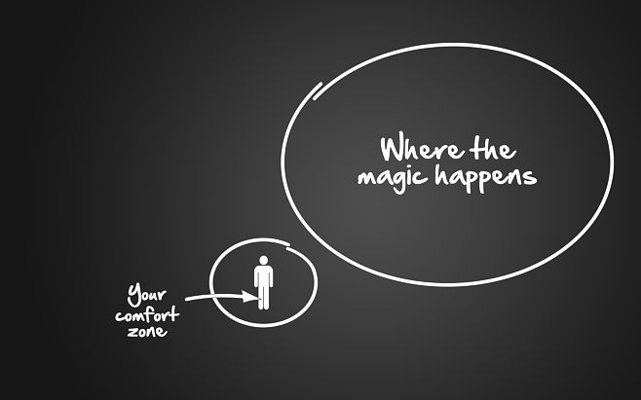
Life begins at the edge of your comfort zone.
--Yubing Zhang

Slide 25
Thank you！

