Slide 1
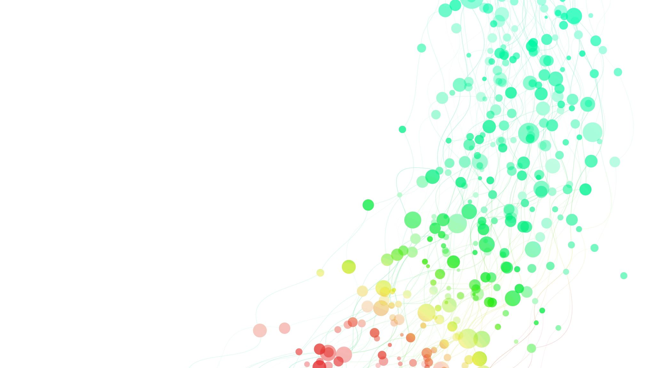
Learning about English

Slide 2
Target Students
Learning Objectives
Teaching Arrangement
Teaching Philosophy
1
Teaching
Design
2
3
4

Slide 3
Target Students
Freshmen / Non-English Majors
Highly-motivated / E-generation
Language proficiency: intermediate English learners
Competences: insufficient critical thinking & collaboration

Slide 4
Teaching Philosophy
collaborate
evaluate
assimilate
cultivate
Learning-
centered

Slide 5
Online preview
Pre-class
(online)
Practice
Discussion
Analysis
In-class
(offline)
Practice
Presentation
Additional learning
After-class
(online)
Writing & Revision

Slide 6
Multiple Assessments
Online learning
Class involvement
Oral presentation
Assigned writing
Teacher
Peer
Self

Slide 7
Learning Objectives of the Unit
Write and talk about the glorious messiness of Chinese language
Reasoning skill
Critical thinking
Linguistic ability
Cultural awareness
Thinking ability
Learning ability
Importance of tolerance and respect toward other cultures
National pride in the glorious Chinese language and its culture
Autonomous learning
Collaborative learning

Slide 8
Teaching Arrangement of the Unit
Session 3
Session 2
Session 1
Period 5:
Oral presentation & Feedback
Period 3:
The development of Chinese language
Period 1:
The history of English language;
Theme analysis
Period 6:
Debate & Reflection
Period 4:
Further discussion on Text B: Why is Chinese changing?;
Peer review of assigned writing
Period 2:
Detailed study of the language points and the borrowed words in English and Chinese
Know
Comprehend
Apply
Reflect
Assimilate

Slide 9
Learning about English
Text A
The Glorious Messiness of English

Slide 10
astronaut
cosmonaut
(Russia, Greek)
taikonaut
(China)

Slide 11
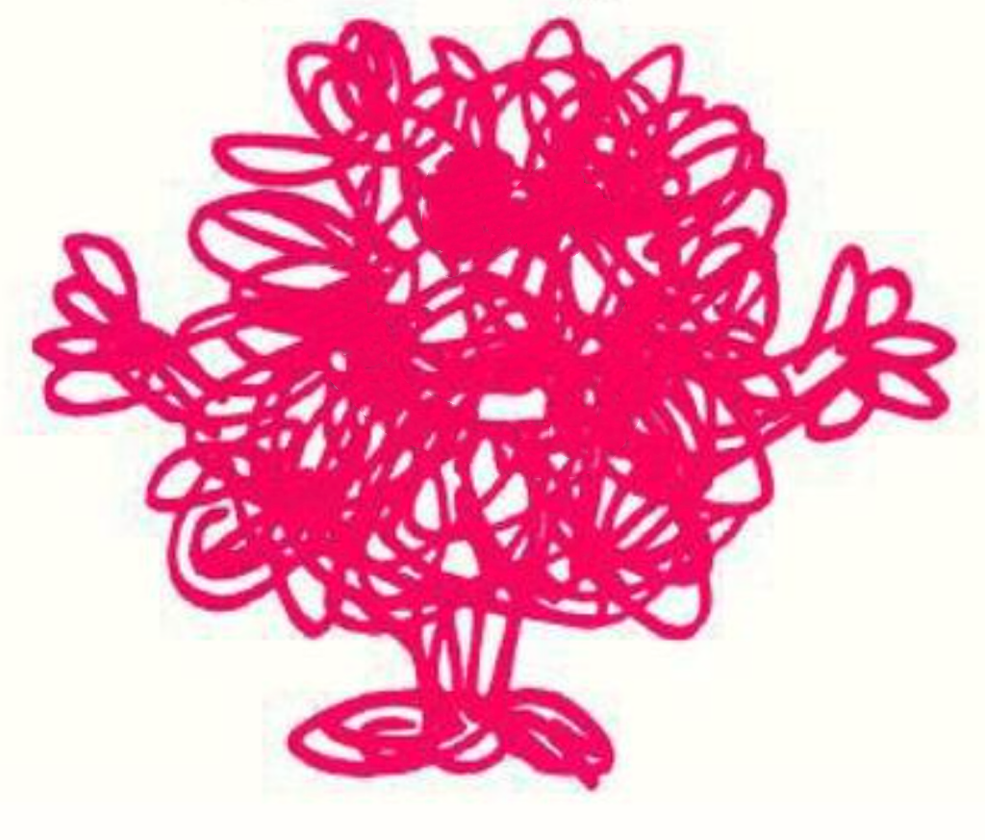
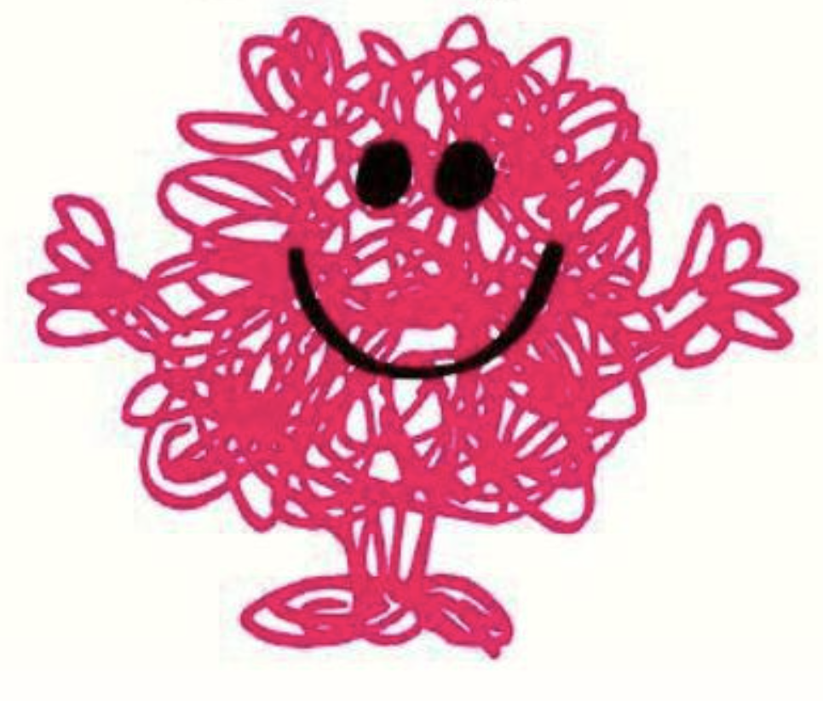
The Glorious Messiness of English
Why is English messy?
Why is the messiness of English glorious?

Slide 12
Task 1 : Why is English messy?
European Renaissance &
the Printing Press
Settlement in America &
the Founding of the United States
The parent language of English
Germanic Settlements
Christian Religion
Vikings
Invasions
Norman Conquest
?
?
?
Events
Changes
the Indo-European
language
Anglo-Saxon
(Old English)
Old Norse
French
(Middle English)
Latin
Greek
American English
?
Greek
Latin
?
?
Paras. 4–9
Paras. 10–11
Para. 12
Para. 13
Para. 14
Para. 15
Para. 16
The History of the English Language

Slide 13
What does “messiness” mean in the text?
a state of being dirty and/or untidy
a situation of being unpleasant, confused or difficult to deal with
a situation when things from different sources coexist in the same environment

Slide 14
Task 1 : Why is English messy?
It has an extremely large vocabulary with multiple sources.

Slide 15
Task 2 :
Why is the messiness of English glorious?
Willingness to accept new things
Love of freedom
Respect for the rights of others
Tolerance for change
 | Attitudes toward language change | Results of the different attitudes
The French
The English
do not like
government tries to ban
only about 75,000 words
happy tolerance, willingness to accept words from anywhere;
great respecters of the liberties of each individual;
freedom to strike out new paths
The richness of English language
an estimated vocabulary of over one million words;
the first global language
A living history of the language’s diverse and vibrant contact with other cultures

Slide 16
Theme Exploration
The relation between
messiness and being glorious
Brainstorm： Is there something messy but glorious?

Slide 17
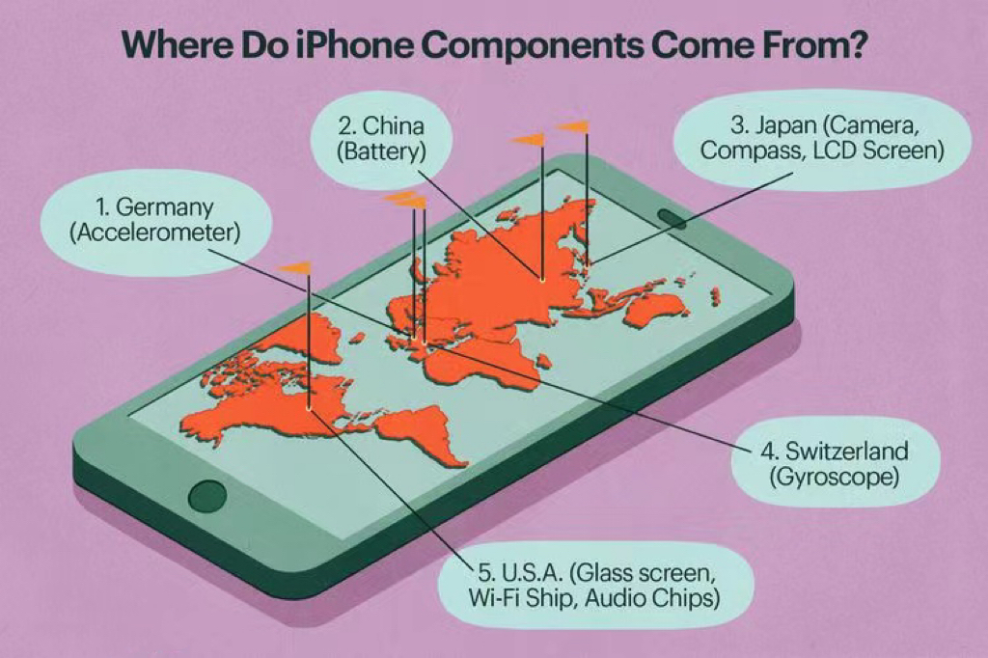
Components from different sources
smartphone

Slide 18
In the era of globalization, what are your attitudes toward the rapidly changing world?

Slide 19
Have the tolerance for other cultures and the willingness to embrace the good parts of other cultures.
Preserve and promote our Chinese culture.
Have confidence in the glorious and profound Chinese culture.

Slide 20
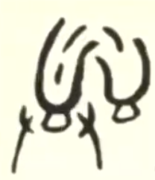
The glorious and profound Chinese characters
容
易
tolerance
change

Slide 21
The Glorious Messiness of English
tolerance
freedom
respect
glorious

Slide 22
Assignments
21世纪是汉字发挥威力的时代。— 安子介
The 21st century is the era of Chinese characters bringing their great potential into full play. — Ann Tse-kai
汉字是中国文化之根; 汉字是国家统一之本; 汉字是国人立命之神。 — 萧启宏
Chinese characters are the roots of Chinese culture, the basis on which the nation remains unified, and the Guardian of the Chinese people. — Xiao Qihong
Do research on the development of Chinese language and list the important events and changes in chronological order.
Group discussion on the question below and be ready to report to the class.
- How is the Chinese language glorious?

Slide 23
Self-assessment checklist
 | Checklist | Yes | No | Not Sure
1 | Do you know the history of English language?
2 | Do you understand the changing nature of languages and acquired a tolerance for such changes?
3 | Do you understand the importance of tolerance and respect for a glorious future?
4 | Do you realize the Chinese characters are glorious?

Slide 24
Thank you for your attention!

