Slide 2
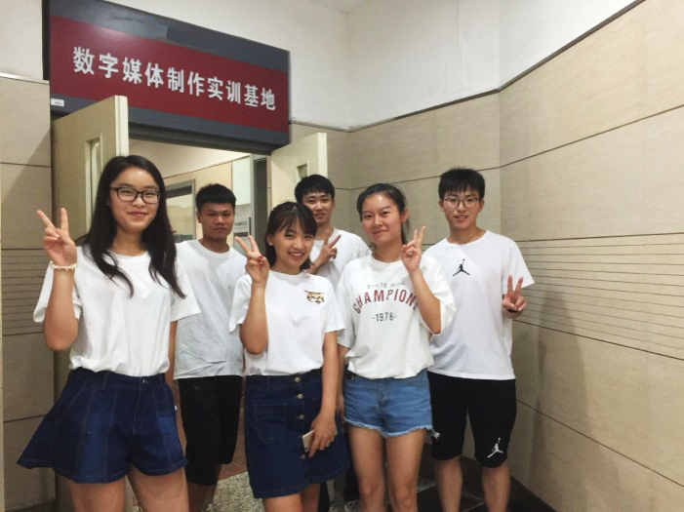
Target Students
Freshmen
Digital Media Art and Design
Willing to enhance
English
proficiency
Lack self-learning strategies
Take on the responsibility of spreading Chinese stories
Have weak output abilities

Slide 3
| Teaching Method
Learning Objectives
Unit Learning Objectives
Multicultural Exchange
English Communication
Awareness of Chinese Culture
Spread Chinese culture
Autonomous Learning
Thinking Quality

Slide 4
Learning Objectives | Teaching Method
Teaching Method
Learning through Doing
Make a leaflet
4
POA
Make up a dialogue
Telling China’s stories
3
Write an email
Pete’s first day in China
2
Greet and introduce people
Getting along with the Chinese
1
Meeting people from different cultures
Offline
Activate
Acquire
Apply
Assess

Slide 5
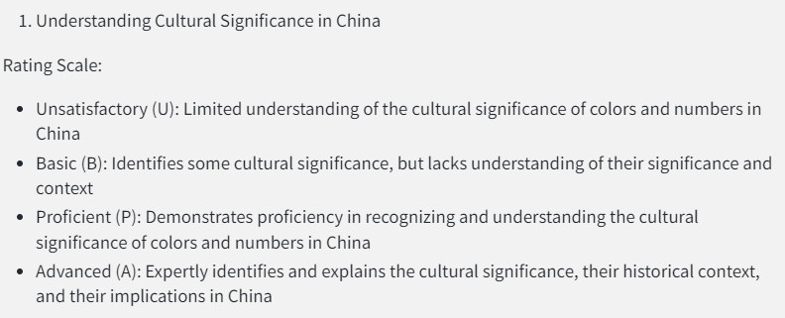
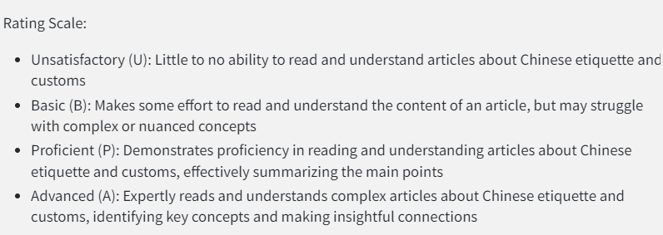
Learning Objectives | Teaching Method
Teaching Method
Learning Assessment
Write an email

Slide 6
Learning Objectives
Knowledge
Understand the key customs, and manners in Chinese society
Recognize some specific social taboos
Skill
Explain the logical relationship between different paragraphs
Attitude
Recognize that differences in manners and customs are not necessarily wrong

Slide 7
People
Notes:
baʊ

Slide 8
Activate
Acquire
Apply
Assess
Scenario
You're working at X-Idea, a multinational media company with employees from diverse cultures. Kate Miller, a colleague from the American office who's been on the same team as you, is coming to China next week for an assignment. While she's excited about the opportunity, she's also concerned about cultural differences. Kate reaches out to you, seeking guidance on adapting to her new environment and building relationships with the Chinese. To help her feel more comfortable and confident, you decide to write her an email.

Slide 9
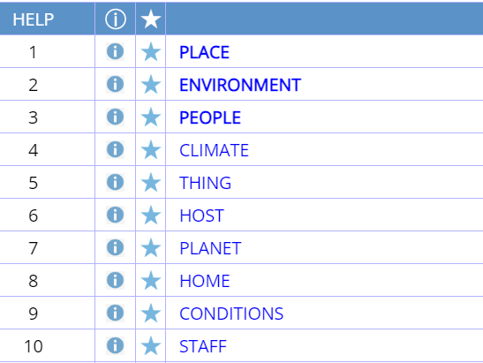
Activate
Acquire
Apply
Assess
Getting Along with the Chinese
1. It’s generally easy to get along with the Chinese, who are usually tolerant and hospitable, but it still helps a lot to know their dos and don'ts.
A hospitable person is friendly, generous, and welcoming to guests or people they have just met.

Slide 10
Activate
Acquire
Apply
Assess
1
Match each paragraph with its corresponding title.
What to write
Para. 2
Para. 3
Para. 4
Para. 5
Para. 6
Para. 7
Para. 8
A. Respect for People Older than You
B. Handshakes and Greetings in China
C. Gift-Giving Etiquette in China
D. Embrace Local Customs, Strengthen Bonds
E. Toasting Etiquette and Attitudes towards Food Waste
F. Tea Etiquette and Handling Bones Properly
G. Managing Personal Questions
B
A
C
E
F
G
D

Slide 11
Activate
Acquire
Apply
Assess
2
Fill in the blanks and answer related questions.
What to write
Para. | Dos | Dont’s
2 | Greet others using a __________or a nod.
3 | _____________ those older than you by their title.
4 | Use __________when you give and receive a gift. | Don’t wrap gifts in ____________ paper.
5 | Join in on each_______and even stand up during formal meals.
handshake
Always address
both hands
Why
black or white
toast

Slide 12
Activate
Acquire
Apply
Assess
2
Fill in the blanks and answer related questions.
What to write
Para. | Dos | Dont’s
6 | Use two fingers to ___________ to say thanks. | Don’t put any bones that you find back into your rice bowl.
7 | Let the person you are talking to know If you don’t want to answer a question. | Don’t ___________ when you are asked personal questions.
8 | “When in Rome, do as the ________ do.”
tap the table
get annoyed
Why
Romans
What

Slide 13
Activate
Acquire
Apply
Assess
3
Read each title again and analyze how they are organized.
What to write
Para. 2 Handshakes and Greetings in China
Para. 3 Respect for People Older than You
Para. 4 Gift-Giving Etiquette in China
Para. 5 Toasting Etiquette and Attitudes towards Food Waste
Para. 6 Tea Etiquette and Handling Bones Properly
Para. 7 Managing Personal Questions
Progression

Slide 14
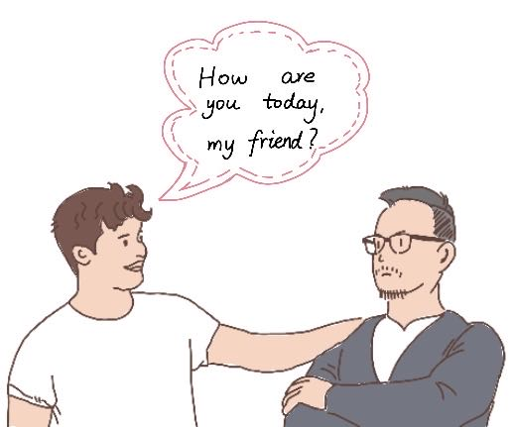
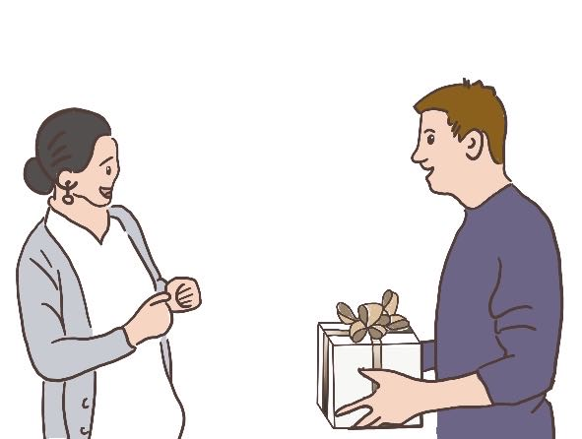
Activate
Acquire
Apply
Assess
4
Analyze cases to check your understanding.
What to write

Slide 15
Thank you

